Slide 1
New Hampshire Statewide Assessments After Testing School Year 2022-2023 October 18, 2022
Notes:
MG

Slide 2
Presented by:
New Hampshire Department of Education (NHED) Staff and Cambium Assessment
Kristen Crawford Assessment Administrator
Michelle Gauthier Program Specialist
Annie Wallace Math Education Consultant
Evelyn Chester Cambium Assessment
Notes:
MG

Slide 3
Annually, New Hampshire public schools are required by state law and federal accountability laws to assess students. RSA 193-C Statewide Education Improvement and Assessment Program and RSA 194-B:8,V Charter Public School Requirement Public schools, including charter schools, are responsible for administering and providing access to the statewide assessments. Resources available: Assessment webpage – current information on assessment program Assessment Policy & Procedures Manual – detailed information on assessment requirements All students must participate in grade-level assessments that correspond with the grade in which they are reported in i4see, New Hampshire’s student data management system. Statewide assessments are not a graduation requirement.
Notes:
MG

Slide 4
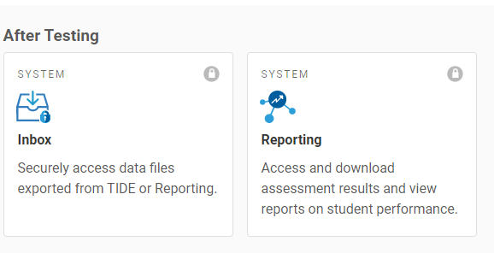
After Testing
Notes:
In today’s webinar, we’ll discuss some of the tasks that occur after students have completed testing. We’ll discuss how to view student results and how to share those results with families.

Slide 5
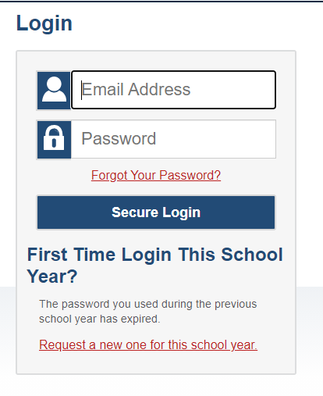
NH SAS Portal
Staff involved in test administration must have a username and password to access TIDE and other applications within the portal
Single sign-on for all systems – TIDE, Test Delivery, Reporting
District coordinators are added by State, school staff should be added by district or school coordinator.
Password resets each school year
https://nh.portal.cambiumast.com
Notes:
EC
As a reminder, all systems for the NH SAS are accessed via the portal and use a single sign on system. To access the Centralized Reporting System, you will use the same username and password that you use to access TIDE or the Test Administration System. If you do not have a username and password, contact your school or district coordinator.

Slide 6
Centralized Reporting System
Notes:
MG

Slide 7
Rosters
Rosters are groups of students associated with a teacher in a particular school
Typically represent entire classrooms in lower grades, or individual classroom periods in upper grades.
Can also represent special courses offered to groups of students.
Guidelines:
25-30 students per roster
Use consistent naming conventions
Teachers can only see test results for students who are associated with them via a roster
Notes:
TG & EC
Teachers can only see test results for students who are associated with them via a roster. Rosters may be set at any point during the school year.
Rosters are groups of students associated with a teacher in a particular school. They typically represent either a classroom or a class period, but you can create rosters for any group of students, including things like reading groups, students receiving certain accommodations, etc. We recommend that a roster have no more than 25-30 students on it, and that you use consistent naming conventions when creating rosters so that you can find them again later.
You can view and edit rosters in CRS or TIDE.

Slide 8
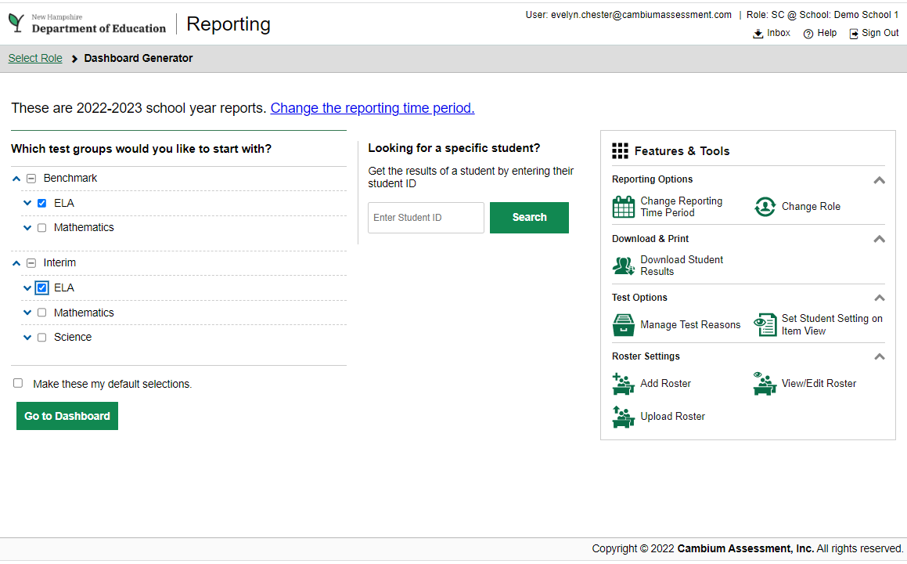
Reporting
Notes:
We’ll now move to a live demo of the reporting system. To access the CRS, start with the NH SAS Portal. Select the appropriate user card, then click on Reporting. Log in with the same username and password you use for other CAI systems. The first screen you’ll see is the Dashboard generator. This page allows you to select which tests you will see on your Reporting dashboard. You can also opt to set these as your default selections. On the right-hand side of the screen, you’ll also see some features and tools. Here you can change the reporting time period, change your role (if applicable), work with rosters, and more.

Slide 9
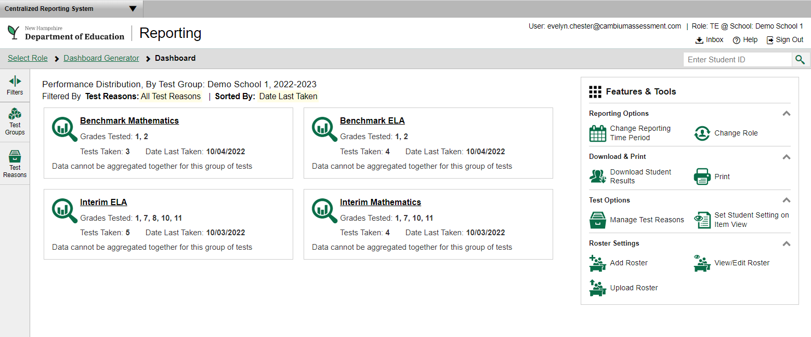
Reporting Dashboard
Notes:
This is the Centralized Reporting System Dashboard. This reflects the tests you chose on the previous screen. From here, we can drill down into individual tests and student results.

Slide 10
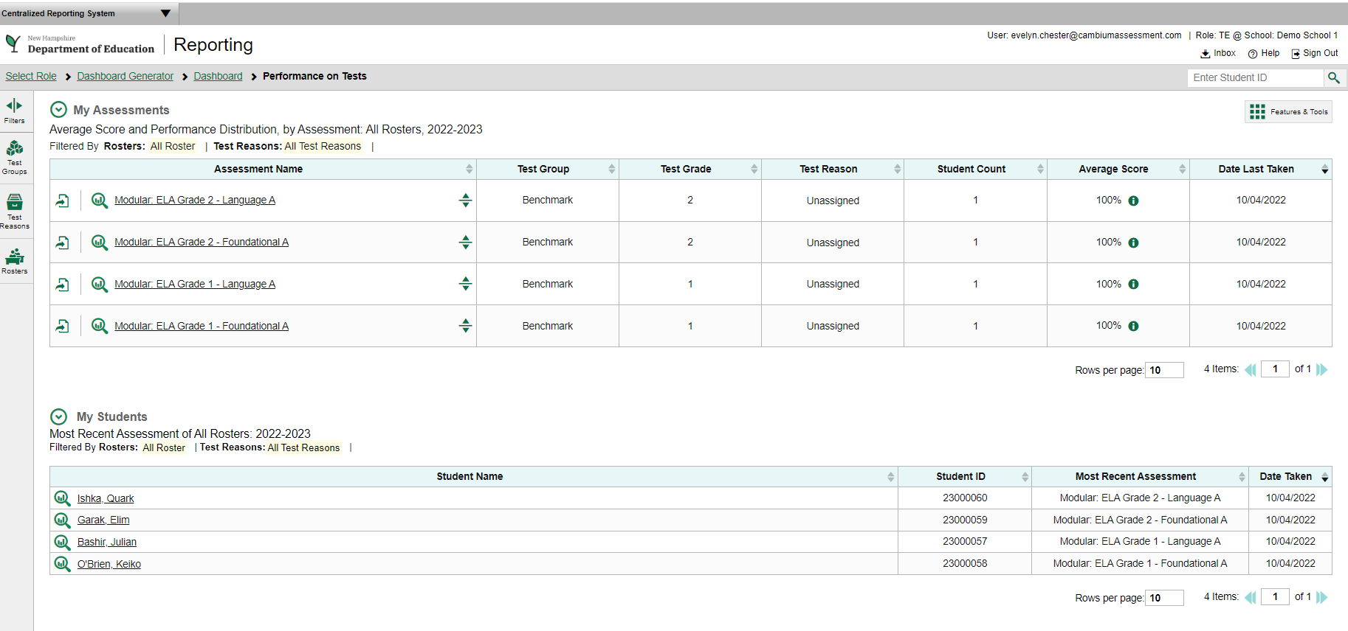
Notes:
Here we see the performance of students across all ELA Modular assessments.

Slide 11
Family Portal
Notes:
MG

Slide 12
Family Portal
https://nh-familyportal.cambiumast.com/
Provides Summative Assessment results to families
Spring 2022 summative assessment results are currently available on the Family Portal
Requires a unique access code
Resources available on the NH SAS portal
Notes:
The Family Portal is a new tool for sharing assessment results with families. Instead of printing Individual Student Reports, schools can share a digital version with families using the Family Portal. Currently, the Family Portal only has results for the 2022 Spring Summative Assessments. The URL for the family portal is listed on this slide. We’ll do a live demo of what the family portal looks like and how families access it.

Slide 13
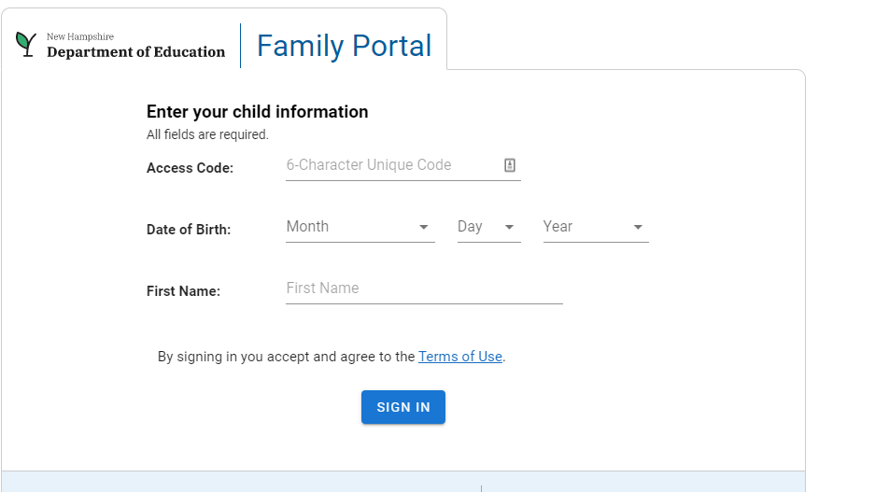
Notes:
Families need to have their students’ First Name as it appears in TIDE, their date of birth, and a unique access code. This access code is provided by the school.
With those three pieces of information, families can log into the portal to view their students’ scores. Currently, the family portal only contains results from the Spring 2022 Summative assessments. Going forward, more results will be added as they become available.

Slide 14
Family Portal Access Codes
Schools are responsible for generating and distributing access codes to families
Students must be in TIDE in order to have a Family Portal Access Code.
Codes are generated in TIDE
Schools may print or distribute them via their school portals
TIDE users with the role of district coordinator, school coordinator and teacher can retrieve access codes
Notes:
Schools are responsible for sharing family portal access codes with families. These access codes are generated in TIDE. You may choose to print these access codes, share them via email, or distribute them via a secure school portal.
Templates for sharing this information with families are available on the portal. We also have documentation on how to generate these codes available on the portal.

Slide 15
Questions?
Notes:
What questions do you have?

Slide 16
Contact Information
Kristen Crawford Assessment Administrator 603-271-3453 Kristen.S.Crawford@doe.nh.gov | Michelle Gauthier Program Specialist 603-271-3582 Michelle.E.Gauthier@doe.nh.gov
General email: Assessment@doe.nh.gov
New Hampshire Help Desk:
1-844-202-7584 I nhhelpdesk@cambiumassessment.com
When contacting the NH Help Desk, provide as much detail as possible about the issue. Details should include:
Type of device being used for testing
Any error messages that appeared
Operating system, network configuration and browser
Contact information for follow-up >> email address and phone number
School name and 8-digit student identifier (SSID), grade level and content area
Do not provide student’s name, only SSID
Notes:
MG
Protect student privacy

