Slide 1
New Hampshire Statewide Assessments Accommodations School Year 2022-2023 October 20, 2022
Notes:
MG

Slide 2
Presented by:
New Hampshire Department of Education (NHED) Staff and Cambium Assessment
Kristen Crawford Assessment Administrator
Michelle Gauthier Program Specialist
Annie Wallace Math Education Consultant
Evelyn Chester Cambium Assessment
Notes:
MG

Slide 3
Annually, New Hampshire public schools are required by state law and federal accountability laws to assess students. RSA 193-C Statewide Education Improvement and Assessment Program and RSA 194-B:8,V Charter Public School Requirement Public schools, including charter schools, are responsible for administering and providing access to the statewide assessments. Resources available: Assessment webpage – current information on assessment program Assessment Policy & Procedures Manual – detailed information on assessment requirements NHSAS Accommodations, Designated Supports & Universal Tools Guide – This Guide is for NH SAS only. Each assessment system (i.e., SAT, DLM Alternate Assessment ACCESS for ELLs) has its own accommodations guide.
All students must participate in grade-level assessments that correspond with the grade in which they are reported in i4see, New Hampshire’s student data management system. Statewide assessments are not a graduation requirement.
Notes:
MG

Slide 4
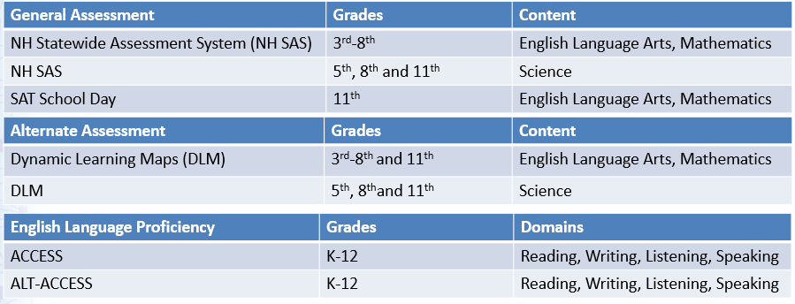
Required Statewide Assessments
Alternate Assessments
Students who have the most significant cognitive disabilities take the alternate assessments, as designed in their active individualized education program (IEP).
Notes:
MG
Most students take the general assessments (NH SAS and/or SAT).
Only a very small percentage of students take the alternate assessment, 1% of students.
Students with severe disabilities , may have multiple disabilities.

Slide 5
Eligibility for Participation in NH SAS
IEP teams should use the Accommodations & Alternate Assessment Decision Making Worksheet for Participation of Students with Disabilities in Statewide Assessments to determine if the general assessment (NH SAS and SAT School Day) with or without accommodations or the alternate assessment is appropriate. DLM is the alternate assessment for severely cognitively disabled students.
Students enrolled in a U.S. school for less than 12 months and identified as active English Learners, based on WIDA Screener, are exempt from ELA portion of the statewide assessments. Students are still required to take mathematics and science portions of the statewide assessments, but their scores will not be included for accountability purposes. Please contact EL Education Consultant Wendy.L.Perron@doe.nh.gov for more information.
Notes:
MG
As a reminder, the alternate assessment is for a very small percentage of students (1%)

Slide 6
Checklist for NHSAS Accommodations & Designated Supports
Determine Accommodations or Designated Supports
Document in IEP, 504 or English Learner Plan
Students are registered for NH SAS via the i4see system by i4see coordinator or designee. Student data transfers overnight from i4see to the TIDE system.
Enter Accommodations, Designated Supports in TIDE
Practice with students on how to use Accommodations and Designated Supports through the student practice site available on the NH SAS portal.
Must have parent permission
Access NHSAS portal to complete the required Test Administration Certification training. This is an annual requirement.
Notes:
MG

Slide 7
Universal Tools vs. Designated Supports vs. Accommodations
Universal Tools are available to ALL students based on student preference, such as highlighting and print size/zoom.
Designated Supports are available for use by any student for whom the need has been indicated by a team of educators (in the school) in collaboration with parent/guardian.
Accommodations are for students for whom there is documentation of the need on an Individualized Education Program (IEP) or Section 504 plan.
Embedded vs. Non-Embedded
Embedded: built into the test system, e.g., text-to-speech, American Sign Language, magnification
Non-embedded: external to the test system and provided to the student by the school, e.g., scribe, separate setting
Notes:
Here we outline the difference between Accommodations, Universal Tools, and Designated Supports. We’ll go into more detail on Accommodations and Designated supports later in this presentation.
Universal Tools are those tools that are available to all students taking a given test. This includes tools like highlighting and masking.
Designated Supports are available for students for whom the need has been indicated by a team of educations in collaboration with parents or guardians.
Accommodations are changes in procedures or materials for students who have documented need on an IEP or 504 plan.
There are a number of Universal Tools that are embedded in the test system. Additionally, accommodations and designated supports may be either embedded or non-embedded. Those that are embedded are built into the test system and delivered as part of the online test. Non-embedded means that the support or accommodation is external to the test system.

Slide 8
Accommodations
Notes:
Now we’ll talk about Accommodations

Slide 9
Accommodations
Differ from designated supports and universal tools.
Changes in procedures or materials that increase equitable access during assessment.
Accommodations generate valid assessment results for students who have a documented need.
They allow identified students to show what they know and can do.
NH SAS Accommodations, Designated Supports and Universal Tools Guide lists the accommodations available to students participating in NH SAS.
Notes:
What is an accommodation? Accommodations are changes in procedures or materials that increase equitable access during the NH SAS Assessments. Accommodations are not modifications, and tests taken with accommodations yield valid scores that count as participation in assessments. Accommodations allow identified students to demonstrate their knowledge and skills.

Slide 10
Accommodations
Available only to students whom there is a documented need:
Individualized Education Program (IEP); or
Section 504 plan; and/or
EL Education Plan such as Documentation of Accommodations for ELLs for Statewide Assessments or equivalent documentation.
The exception is for students who have had a physical injury (e.g., broken hand or arm) that impairs their ability to use a computer. These students may use the speech-to-text or the scribe designated support (if they have had sufficient experience with the use of these).
Notes:
Accommodations are only appropriate for students for whom there is a documented need. That need must be documented on an IEP, 504 plan, or an EL Education Plan. The exception to this rule is if a student has experienced a physical injury that temporarily impairs their ability to take the computer-based test, for example, a broken arm. These students may be eligible for accommodations that allow them to access the test. As with all other accommodations, students who require an accommodation due to injury must have sufficient experience with the use of the accommodation.

Slide 11
Accommodations
Accommodations may be digitally-embedded or non-embedded
Embedded is built into the test system, e.g., text-to-speech, American Sign Language, magnification
Non-embedded is external to the test system and provided by the school, e.g., color overlay, separate setting
Notes:
As we mentioned previously, accommodations may be either embedded or non-embedded. Embedded accommodations are built into the test system and administered digitally via the test delivery system. Examples of embedded accommodations are text-to-speech, ASL videos, or an increased default zoom size. Non-embedded accommodations are those that are external to the online test platform. These may include things such as a color overlay that goes on the student’s monitor, or a separate setting for test administration.

Slide 12
Determination of Accommodations
Determination of accommodations for an individual student:
Should occur at the beginning of the school year so that accommodations are available prior to test administration.
Determined by a team of educators (for EL students the team must include a certified ESOL teacher; for IEP students the team must include a certified Special Education teacher).
Parent permission is required for students to have use of accommodations for the NH SAS.
Notes:
Determination of accommodations should occur at the beginning of the school year, so that accommodations are available prior to test administration. This ensures that accommodations can be set prior to testing and allows students to have the opportunity to practice with these accommodations prior to testing.
Accommodations are determined by a team of educators. For EL students, this team must include a certified ESOL teacher; for students with an IEP this team must include a certified Special Education teacher.
Parent permission is required for students to have use of the accommodations for the NH SAS.

Slide 13
Recording Accommodations
Both embedded and non-embedded accommodations must be entered into the TIDE system, so they are reflected in the assessment the student receives and there is an accurate record kept of the student test environment.
Notes:
Both embedded and non-embedded accommodations need to be recorded into TIDE. For embedded accommodations this is particularly important as this is what drives the delivery of those accommodations.
Accommodations must also be entered into NHESIS for students that have IEPs.

Slide 14
Designated Supports
Notes:
Next, we’ll discuss Designated Supports. But first, are there any questions about Accommodations?

Slide 15
Designated Supports
Designated Supports are accessibility features available for use by any student for whom there is a documented need.
Designated supports selected should also be consistently used during the student’s instruction in the classroom.
NH SAS Accommodations, Designated Supports and Universal Tools Guide lists the designated supports available to students participating in NH SAS.

Slide 16
Determination of Designated Supports
Only appropriate for a student that has a documented need determined by a team of educators (in the school) that have knowledge on the use of designated supports and understand the types of designated supports available.
Designated supports need to be identified prior to test administration.
Must be approved by the building principal or administrator.
Parent permission is required for students to have use of designated supports for the NH SAS.
Notes:
Designated Supports are only appropriate for students who have a documented need. This need is determined by a team of educators, and must be approved by the building principal or administrator. Parent permission is required for students to have use of designated supports on the NH SAS. Again, this determination needs to occur prior to test administration.

Slide 17
Designated Supports
Designated Supports can be digitally-embedded or non-embedded
Both embedded and non-embedded designated supports must be entered into the TIDE system, so they are reflected in the assessment the student receives and there is an accurate record kept of the student test environment.
Notes:
Just like accommodations, designated supports may be either embedded or non-embedded. Both embedded and non-embedded designated supports must be entered into TIDE prior to testing.

Slide 18
Setting Accommodations and Designated Supports
Accommodations and Designated Supports are set in TIDE prior to test administration
Set individually or via upload in TIDE

Slide 19
Practicing with Accommodations and Designated Supports
Notes:
Students should be given adequate opportunities to practice testing with the Accommodations and Designated Supports they will use during summative testing. Ideally, these should be tools that they use in daily classroom instruction.
There are two main ways to practice with these tools – the Practice Tests, and the Interim & Modular Assessments.

Slide 20
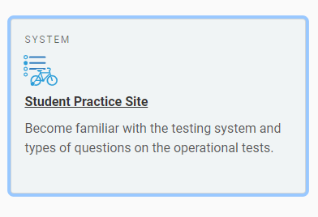
Practice Tests
It is recommended that students and teachers use the practice site to become familiar with the testing system.
Not scored
Non-secure
Do not require student information to log in
Notes:
The Practice Tests are available on the NH SAS portal. They are non-secure items and the tests are not scored. There is a guest user option so that families and members of the public may access them. The Practice Tests are designed to allow students, teachers, and families to become familiar with the structure and functionality of the test. Students can use them to practice answering different item types and using different built-in tools, such as the highlighter, calculator, or strikethrough. Educators can use them to preview what different color settings or other accommodations will look like.

Slide 21
Interim and Modular Assessments
Scored tests, with results in Centralized Reporting System
Secure items
Interims
Adaptive
Secure Browser Required
ELA and Math
Modulars
Fixed-form
Any browser
ELA, Math, and Science
Notes:
The Interim Comprehensive and Modular Benchmark Assessments are another testing resource. The Interim Comprehensives are available for ELA and Math, and are shorter computer-adaptive tests, very similar to the Summative assessment students take in the Spring.
Modulars are shorter, fixed-form tests that focus on a particular topic. They are available for ELA, Math, and Science.
Both are scored, with results available in the Centralized Reporting System. Interims must be taken using the Secure Browser, while the modulars may be taken in either the secure browser or a standard browser such as Chrome or Firefox.
These tests have a number of instructional uses and can help identify areas of strengths and weaknesses. They are also a great opportunity for students and teachers to practice testing prior to summative assessments. Students taking these tests should be using the same accommodations and designated supports that they will use during summative testing. This is especially helpful for students who use assistive technology, as it allows an opportunity to ensure that all technology is functioning properly and that students have an opportunity to practice with it.

Slide 22
Resources
Notes:
What questions do you have?

Slide 23
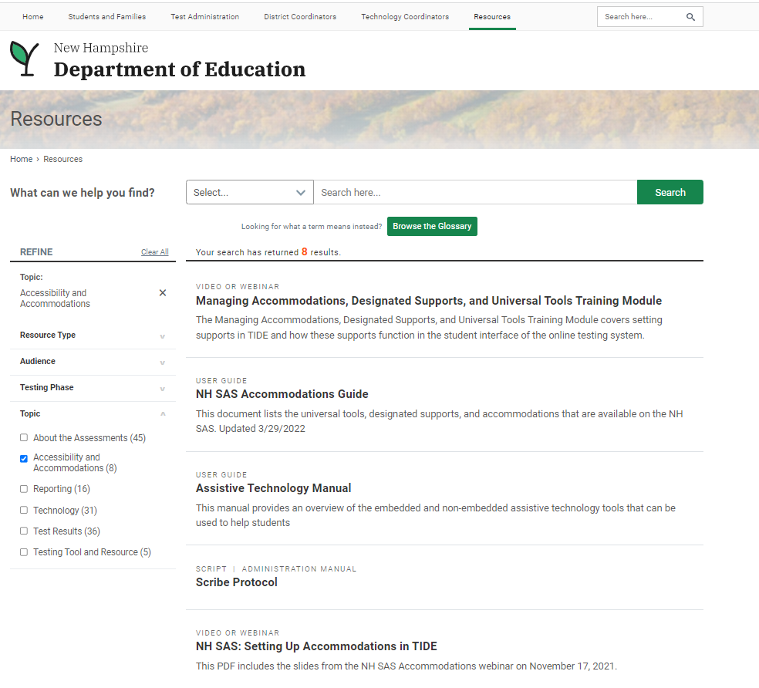
Accessibility and Accommodations Resources
Managing Accommodations, Designated Supports, and Universal Tools Training Module
NH SAS Accommodations Guide
Assistive Technology Manual
Notes:
The Resources section of the NH SAS portal contains a number of resources related to Accessibility and Accommodations. I’d like to draw your attention to three of them:
The Managing Accommodations, Designated Supports, and Universal Tools Training Module
The NH SAS Accommodations Guide
And the Assistive Technology Manual.
This is also where you would find the recording of this webinar.

Slide 24
Questions?
Notes:
What questions do you have?

Slide 25
Contact Information
Kristen Crawford Assessment Administrator 603-271-3453 Kristen.S.Crawford@doe.nh.gov | Michelle Gauthier Program Specialist 603-271-3582 Michelle.E.Gauthier@doe.nh.gov
General email: Assessment@doe.nh.gov
New Hampshire Help Desk:
1-844-202-7584 I nhhelpdesk@cambiumassessment.com
When contacting the NH Help Desk, provide as much detail as possible about the issue. Details should include:
Type of device being used for testing
Any error messages that appeared
Operating system, network configuration and browser
Contact information for follow-up >> email address and phone number
School name and 8-digit student identifier (SSID), grade level and content area
Do not provide student’s name, only SSID
Notes:
MG
Protect student privacy

