Slide 1
New Hampshire Statewide Assessments “During Testing” School Year 2022-2023 October 13, 2022
Notes:
MG

Slide 2
Presented by:
New Hampshire Department of Education (NHED) Staff and Cambium Assessment
Kristen Crawford Assessment Administrator
Michelle Gauthier Program Specialist
Annie Wallace Math Education Consultant
Evelyn Chester Cambium Assessment
Notes:
MG

Slide 3
Today’s Topics – During Testing
Test Administration Certification
Test Administrator (TA) Interface
Creating Interim and Modular Test Sessions
Assessment Viewing Application (AVA)
Monitoring Test Progress
Questions
Notes:
MG

Slide 4
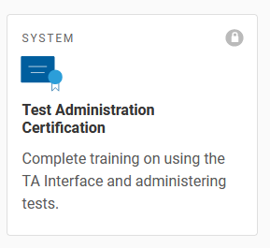
Test Administration Certification
Every year, Test Administrator/Proctors must take the TA Certification Course in order to gain access to the TA Interface
Notes:
MG

Slide 5
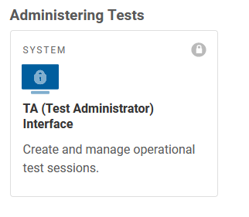
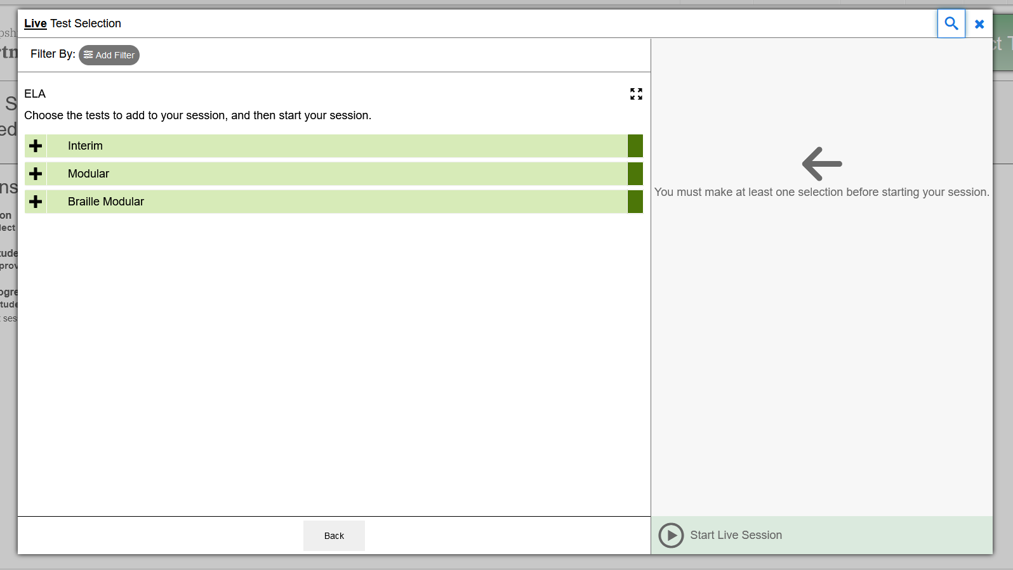
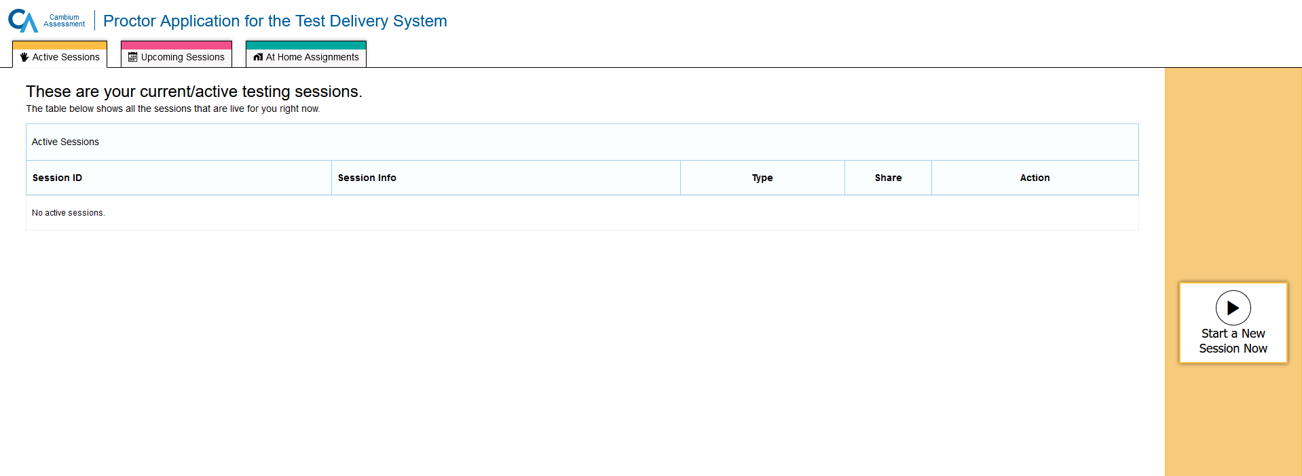
TA Interface
The TA Interface is where Teachers and Proctors create Interim and Modular test sessions.
Notes:
EC

Slide 6
TA Interface
Live TA Interface Demo
Notes:
EC

Slide 7
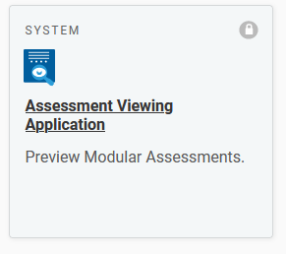
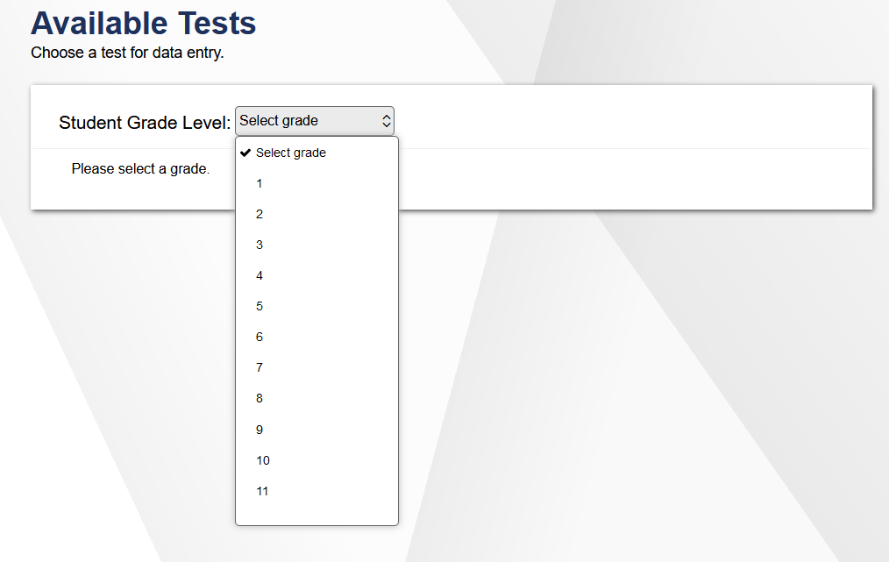
Assessment Viewing Application (AVA)
Notes:
EC

Slide 8
AVA
Live AVA Demo
Notes:
EC

Slide 9
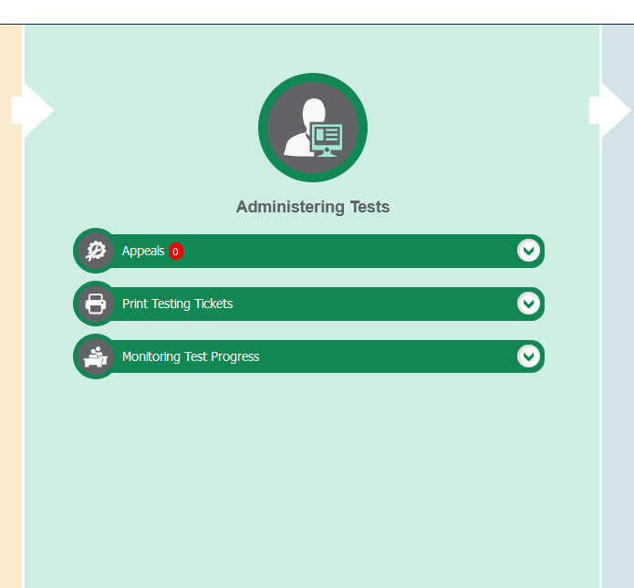
Monitoring Test Progress
Notes:
EC

Slide 10
Monitoring Test Progress
Live demo of test progress tools
Notes:
EC

Slide 11
QUESTIONS???
Notes:
EC

Slide 12
Contact Information
Kristen Crawford Assessment Administrator 603-271- 3453 Kristen.S.Crawford@doe.nh.gov | Michelle Gauthier Program Specialist 603-271-3582 Michelle.E.Gauthier@doe.nh.gov
General email: Assessment@doe.nh.gov
New Hampshire Help Desk:
1-844-202-7584 I nhhelpdesk@cambiumassessment.com
When contacting the NH Help Desk, provide as much detail as possible about the issue. Details should include:
Type of device being used for testing
Any error messages that appeared
Operating system, network configuration and browser
Contact information for follow-up >> email address and phone number
School name and 8-digit student identifier (SSID), grade level and content area
Do not provide student’s name, only SSID
Notes:
EC

