Slide 1
New Hampshire Statewide Assessment System 2023-2024
Notes:
MG

Slide 2
Presented by:
New Hampshire Department of Education
Nate Greene Administrator, Bureau of Assessment & Accountability
Kristen Crawford Assessment Administrator
Michelle Gauthier Assessment Specialist
Cambium Assessment
Tom Glorfield Senior Program Manager
Evelyn Chester Program Manager
Sharif Jico Program Manager
Julie Benson Content Director

Slide 3
Statewide Assessments
Assessment | Grades | Content
NH Statewide Assessment System (NH SAS) | 3-8 | English Language Arts, Mathematics
NH SAS | 5, 8 and 11 | Science
New Hampshire’s SAT School Day with Essay | 11 | English Language Arts, Mathematics
Dynamic Learning Maps (DLM) Alternate Assessment | 3-8 and 11 | English Language Arts, Mathematics
DLM | 5, 8, and 11 | Science
ACCESS/Alternate ACCESS | K-12 | English Language Proficiency

Slide 4
2023-2024 Assessment Schedule
New Hampshire Statewide Assessment System (NH SAS)
Grade Level | Content Area | Testing Window
3-8 | ELA Writing Only | March 4 – 15, 2024
3-8 | ELA Reading, Math | April 1 – June 7, 2024
5, 8, 11 | Science | April 1 – June 7, 2024
New Hampshire’s Digital SAT School Day with Essay
Grade Level | Content Area | Testing Window
11 | ELA, Math | March 25 – April 5, 2024
SAT Make-up Days:
11 | ELA, Math | April 8 – 12, 2024
Dynamic Learning Maps Alternate Assessment
Grade Level | Content Area | Testing Window
3-8 and 11 | ELA, Math | March 11 – June 7, 2024
5, 8, 11 | Science | March 11 – June 7, 2024
WIDA: ACCESS for ELLs and Alternate ACCESS
Grade Level | Content Area | Testing Window
K-12 | Reading, Writing, Listening, Speaking | February 1 – March 22, 2024
Notes:
Testing window is only for spring 2024. The regular testing window will resume next year.

Slide 5
Who Should Test?
Annually, New Hampshire school districts and public charter schools are required by state law (RSA 193-C) and federal accountability laws (Every Student Succeeds Act) to assess students using a standardized assessment.
All students must participate in grade-level assessments that correspond with the grade in which they are reported in i4see, New Hampshire’s student level data collection system. All students include:
Students placed in private special education programs/schools who receive special education services that are publicly funded, including approved and non-approved private special education schools located within and outside New Hampshire.
Students placed in general education programs/schools outside of the district, including schools within and outside New Hampshire.
Students in institutional settings who receive educational services from the district.
Students in the custody of the New Hampshire Division of Children, Youth and Families (DCYF).
Court-ordered placements – students who are placed by the court in approved and non-approved private general or special education schools within and outside New Hampshire.
Students attending an alternative school day (such as an adult high school) who are being monitored and reported by the school.
Notes:
including students with disabilities and English learners

Slide 6
Key Tasks for Test Coordinators
Oversees all test procedures and ensures district staff/building staff is administering the required statewide assessments with integrity.
Makes sure all staff involved in testing are trained properly in test administration and test security.
Reviews and updates NH SAS user accounts at least annually. Remove users who longer work for the district/school or need accounts.
District coordinator can create user accounts in TIDE for school coordinators and testing staff within the district.
School coordinator can create user accounts in TIDE for testing staff at the building level.
All testing staff must have a user account in order to access any of the NH SAS systems, i.e., Reporting, Test Administration Interface, Test Administration Certification Training.
Ensures all testing staff are trained and sign annual affirmation of test security assurances.
Ensures that students receive the appropriate designated supports and accommodations.
Prior to test administration, enters/sets designated supports and accommodations into the TIDE system.
Reports test incidents to the NHED Office of Assessment and assists in resolving incidents.
For consistency, submits appeals in the TIDE system.

Slide 7
Test Security

Slide 8
Annual Test Security Assurances
Affirmation of Test Security for Proctors/Test Administrators
Test administrators/testing staff annually verify that they have read, understand and will abide by NHED test security policies and procedures. This form is kept on file at the district or building level and make available during assessment monitoring.
Policies and procedures are included in the NHED Assessment Policies and Procedures Manual and each Test Administration Manual.
Affirmation of Test Security for Building Principals
Building principals, including charter school leaders, annually verify that all testing staff have or will read, understand, and will abide by NHED test security policies and procedures. This form must be signed and returned to Assessment@doe.nh.gov.
Building principals only need to sign one form per school year for all statewide assessments: NH SAS, New Hampshire’s SAT School Day, DLM Alternate Assessment, WIDA ACCESS/Alternate ACCESS, English Language Proficiency test.
Notes:
Staff Roles Involved with Testing:
Assessment/curriculum coordinators
District and building level test coordinators
Technology coordinators and tech staff
i4see coordinators/local security administrators
School administration and administrative staff, includes special education staff
Test administrators/proctors/teachers
Hall monitors

Slide 9
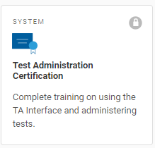
Test Security
Maintaining test security is an important part of test administration, to ensure no student has an unfair advantage or disadvantage in taking the assessment.
All staff involved in test administration or who support testing in any way must:
Complete annual Test Administration Certification training available on the NH SAS portal >Test Administration > under Preparing for Testing, choose Test Administration Certification
Understand test security requirements
Read and use NHSAS Test Administration Manual, TA User Guide, and the Universal Tools, Designated Supports, and Accommodations Guide, when planning and administering the assessments
Notes:
Test security is the actions we take to ensure test content and student responses are protected so that test scores are accurate and meaningful.
The primary goal of test security is to protect the integrity of the assessment and to ensure student test results are accurate and meaningful.
Test materials must be kept in a secure location when not being used in a test administration. Items considered secure test materials include, but not limited to:
Digital assessments
Student test tickets
Student white boards
Scratch paper
Student information

Slide 10
Test Incidents
What is a test incident? A test incident is any event or procedure that may impact a student’s performance or potentially impact the integrity of the assessment. Test incidents may be accidental or intentional and must be reported to district or school test coordinator who then determine if it’s necessary to contact the NHED.
Types:
Test Irregularity is an unexpected event that results in a change to the established test administration. It may impact an individual or group of students’ performance on the test, test security or test validity. Examples: a student not receiving an accommodation that is documented in their IEP or 504 plan, fire alarm or other disruptions.
Technology Incident is an unexpected computer issue that may or may not compromise students’ test results.
Test Security Violation is an incident or breach of New Hampshire’s test security policies and procedures that compromises test security, data security and the integrity of a student’s assessment results.

Slide 11
Test Security Actions
Technology Incident (low-risk)- District or school coordinator resolves incident at the local level and enters an appeal into the TIDE system, if appropriate.
Irregularity (low-medium risk) – Contact the Office of Assessment to report incident. District or school coordinator resolves incident at the local level and enters an appeal into the TIDE system, if appropriate.
Test Security Violation – This is a high-level risk that poses a threat to the validity of the assessment. These circumstances have external implications and may result in the removal of the test item(s) from the secure test item bank. District or school coordinator contacts the Office of Assessment immediately.

Slide 12
Examples of Test Security Violations
Inappropriate use of electronic devices, especially cell phones
A student receives an inappropriate accommodation, i.e., the assessment is read aloud to a student who does not qualify for this type of accommodation/designated support
Coaching students or providing hints to test questions
A student takes the assessment using another student’s test tickets
Leaving students unattended during testing
Taking a picture of a test item
Student cheating

Slide 13
Student Use of Electronic Devices
The use of cell phones, smart watches, and other electronic devices are the most common test security violations.
Examples of Electronic Devices: iPads, Kindles or other e-Readers, smart glasses, AirPods or other headphones, Fitbits, Apple or Samsung watches or any type of watch with access to applications or the Internet.
NHED is creating a policy on the use of electronic devices by students and staff. This policy will provide best practices and guidance for districts on the use of electronic devices during testing. Policy will be available in January 2024.
Access to electronic devices may result in the invalidation of student tests which in turn can negatively impact assessment participation and accountability.
Students are not permitted to use, wear, or to access any personal electronic devices during testing or while on a break when in an active test session, unless medically necessary.
Notes:
In rare cases where test questions, passages or prompts have been posted on social media, the district must immediately work to remove the secure material from social media and any electronic device(s) and contact NHED Office of Assessment.

Slide 14
Policy for Electronic Devices
Students are not allowed to use any electronic devices during testing.
All student electronic devices should be collected upon entering the testing room. Devices should be powered off and stored away from the students.
Electronic devices should be kept in a secure location during testing, i.e., storage cabinet or organizer monitored by staff.
Staff actively confirm that no students have additional electronic devices before, during, and after testing while in an active test session. Testing staff should remind students to check that they have no electronic devices.
Notes:
Test administrator: Do you have earbuds in your ears or in your pocket?” “Are you wearing a smartwatch?”
Test administrators and testing staff must be focused on active monitoring throughout the entire test administration.
Test administrators should not use their personal cell phones. All personal electronic devices are to be silenced to reduce disruptions.
Districts/schools determine how test administrators and testing staff will notify others if a test issue arises in the classroom.
Districts/schools may choose to allow test administrators to use a cell phone as a timekeeper or to perform test-related tasks such as contacting staff during testing.
Testing staff should be reminded to never take pictures of students, test items, computer screens or the testing room during a test session.

Slide 15
Monitoring Students During Testing
Students must be actively monitored at all times by a test administrator or testing staff.
Grading papers, texting or having a personal conversation on a cell phone is not considered actively monitoring students.
A classroom should never be left unattended while students are testing. If a proctor needs a break, another staff member should relieve the proctor.
Stepping into the hallway for a few seconds/minutes is considered leaving students unattended and not maintaining test security.
Notes:
Stepping into the hallway for a few seconds/minutes is considered leaving students unattended and not maintaining test security.

Slide 16
Appeals
Appeals

Slide 17
Types of Appeals
Reset a Test – Removes the test and scores from the system. Enables the student to start a new test.
Reopen a Test – Allows for a test that has already been submitted in error or has expired to be re-opened.
Reopen a Test Segment – Re-opens a test segment allowing a student to access the first segment of a test that was submitted in error.
Grace Period Extension – Granted if a test session is unexpectedly interrupted, i.e., fire alarm. Allows access to previously answered questions.
Invalidate a Test – Removes the test from the system. The student does not receive a score.

Slide 18
Tips on Entering Appeals
For consistency, a district or school coordinator should enter appeals into the NH SAS TIDE system.
The Assessment Team reviews each appeal and does not approve every appeal.
Provide the reason for the appeal. Keep it short and concise.
Students should not be allowed back into their test just to double check their work if they already submitted their test.
Encourage students to review their answers before ending their test.
Contact the Office of Assessment with any questions: Assessment@doe.nh.gov

Slide 19
Assessment Best Practices
Create a positive test-taking environment.
Designate an area for testing that provides a distraction-free environment.
Test administrator must always be present in the classroom.
Students should have the opportunity to go to the restroom before testing starts to minimize distractions.
Students should not have access to electronic devices during testing or on breaks.
Test tickets should be handed out to each student right before testing starts so they may log-in. Test tickets and scratch paper must be collected at the end of the test session.
Become familiar with the test procedures and review scripts outlined in the Test Administration Manual.
Use practice tests/modulars so students are familiar with item types and tools available.
Prior to testing, refer to the allowable designated supports and accommodations described in the Universal Tools, Designated Supports, and Accommodations Guide.

Slide 20
Accessibility and Accommodations

Slide 21
Universal Tools, Designated Supports, and Accommodations
Universal Tools are provided for ALL students based on student preference, i.e., masking, print size, highlight, strikethrough.
Designated Supports are intended for any student (including English learners, students with disabilities, and English learners with disabilities) for whom the need has been indicated by an educator familiar with the student’s needs and approval by the building principal or school administrator. Parent consent is required.
The student’s use of designated supports during the assessment should reflect similar supports also provided during regular classroom instruction and local and statewide assessments given throughout the school year.
Accommodations are for students with disabilities who are receiving special education services and have an active IEP or Section 504 Plan, and for students who are English learners also identified as a student with a disability.
The student’s IEP must specify which accommodations will be used during the assessment and should reflect similar accommodations also provided during regular classroom instruction and local and statewide assessments given throughout the school year.
Notes:
The universal tools, designated supports, and accommodations available on the assessments should reflect similar supports also provided during regular classroom instruction and local assessments given throughout the school year.
A mismatch in the types of supports provided in the classroom and for assessments can cause difficulties for students at the time of testing and could negatively impact students’ test scores.
Students who are given designated supports and accommodations who do not require them can also be given an unfair advantage over other students.
Masking blocks off content that may be distracting for a student. Strikethrough allows student to cross out answer options.
There are two types:
Embedded (built-in tools and settings): Provided by the test delivery system; and
Non-Embedded: Outside of the test delivery system. Provided to the student by the school.
Em

Slide 22
Questions?
Notes:
What questions do you have?

Slide 23
Interim and Modular Assessments
Evelyn Chester, Cambium Assessment, Inc.

Slide 24
Agenda
Overview of Modulars & Interims
Administering Modulars & Interims
Accessing Score Reports
How Interims & Modulars support Teaching and Learning
Notes:
Just a quick agenda here – I want to give you a quick overview of the modulars and interims, then we’ll briefly review how these assessments are administered. We’ll talk about how to access score reports and view student performance on these assessments, and then we’ll discuss how interims and modulars can support teaching and learning in the classroom. I do have some placeholders for questions at the end of each section, but if anything isn’t clear, please feel free to interrupt me to ask! Let’s dive in!

Slide 25
Availability
Test Window starts in the fall and runs through spring
Sept. 19, 2023 – June 7, 2024
Included as part of the NH SAS contract – no added cost to schools/districts
Administered using the same platform as the NH SAS Summative
The same Accommodations, Designated Supports, and Universal Tools are available
Support all the same devices and platforms
Notes:
The Interims and Modulars are available right now – the test window for these generally starts in the fall and runs through the spring. This year we opened up the fall window about a month ago, on September 19, and the tests will be available through June 7, which is the end of the Summative test window as well.
These tests are included as part of the state’s contract with Cambium, so they are available to all schools in the state at no additional cost.
They are administered using the same platform as the NH SAS Summative assessments, which means that all of the same tools, accommodations, designated supports, etc. are available, and we support all the same devices and operating systems.

Slide 26
Interims vs. Modulars
Computer adaptive
Approx 30 items per test
100% machine-scored
Reported in CRS (Centralized Reporting System)
One per grade (ELA/Math)
Unlimited number of opportunities
Secure Browser only
Can be given off-grade
Fixed Form
Average of 12-15 items per test
100% machine-scored
Reported in CRS
Average of 8 per grade (ELA/Math) – 27 for Science (5, 8, 11)
Unlimited number of opportunities
Can be given as homework
Can be given off-grade
Notes:
On this slide we have a bit of a breakdown of the interims versus the modulars.
The Interims are comprehensive, computer-adaptive assessments. They are shorter than the Summative, but they are otherwise very similar.
There are approximately 30 items per test.
The Modulars, on the other hand, are short, fixed-form assessments with an average of 12-15 items per test
In both cases, students have an unlimited number of opportunities –they can test again and again. Because the interims are computer-adaptive, students may see different items in different tests, or they may see the same items in a different order. On the Modulars, students will always see the same items in the same order, but there are generally multiple tests covering the same topic or unit.
All of these tests are 100% machine-scored, and results are sent to the Centralized Reporting System immediately.
And, all of these tests can be given off-grade, so if, for example, you’re a 5th-grade teacher, but you want to give your students a 4th-grade test to check their foundations before you start working on concepts that build on that, you can. Or if you want to give those students a 6th-grade test, you can!
One other thing to note is that while you must use the Secure Browser to administer the Interims – just like the Summatives – the modulars can be given as at-home assignments.
For those of you who have administered these before, I’ll note that we have done a major overhaul of these item banks, so you’ll see brand-new modular assessments, and the interim comprehensive bank draws from a completely different pool.

Slide 27
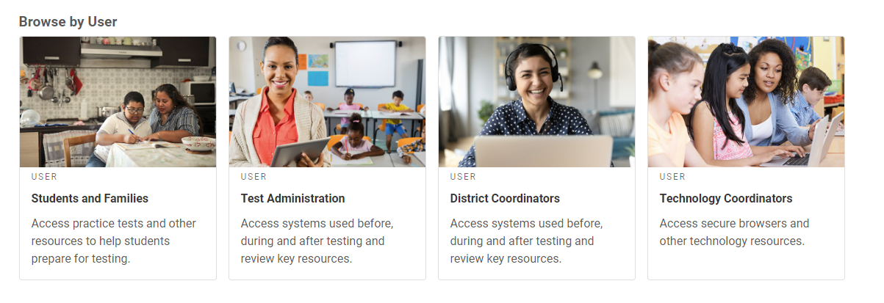
Administrating Interims & Modulars
Assessment Viewing Application (AVA)
https://nh.portal.cambiumast.com
Notes:
Now we’ll talk briefly about how to administer the interims and the modulars. Again, these tests use the same platform and tools that you’re used to if you’ve administered the Summative assessments.
One tool you may not be used to from the Summatives is the Assessment Viewing Application, or AVA, which allows educators to view the ELA and Math Modulars and the Science Interims.
Access to this tool is available via the New Hampshire Assessment Portal. You will need a username and password to access them – this is the same username and password you use to access any other CAI system.
I’m going to take us to the Portal now and do a live demonstration on how to access this tool.
Start by clicking on either the “Test Administration” or “District Coordinators” icon.

Slide 28
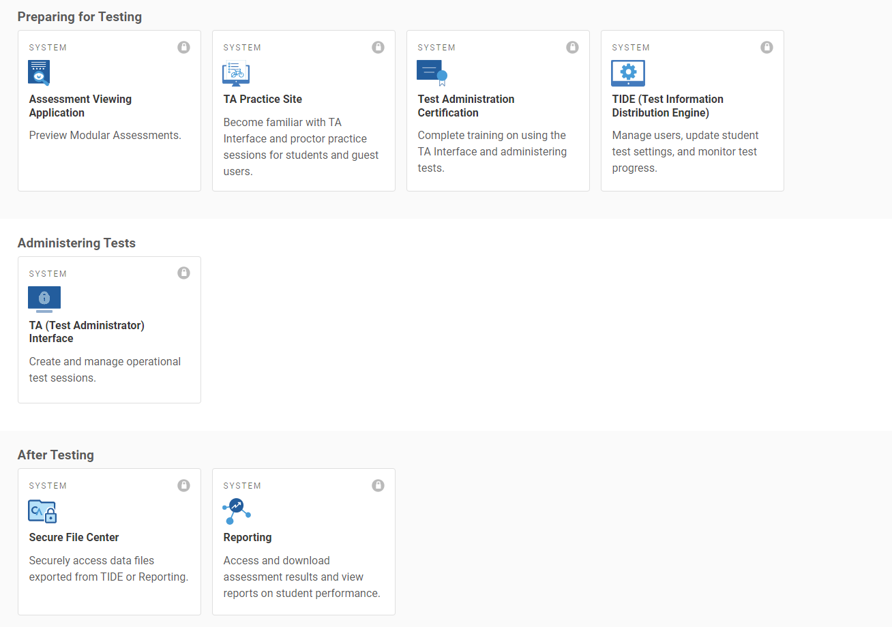
Notes:
AVA will be listed under “Preparing for Testing”.
You will log into AVA using the same username and password that you use for any other CAI system.

Slide 29
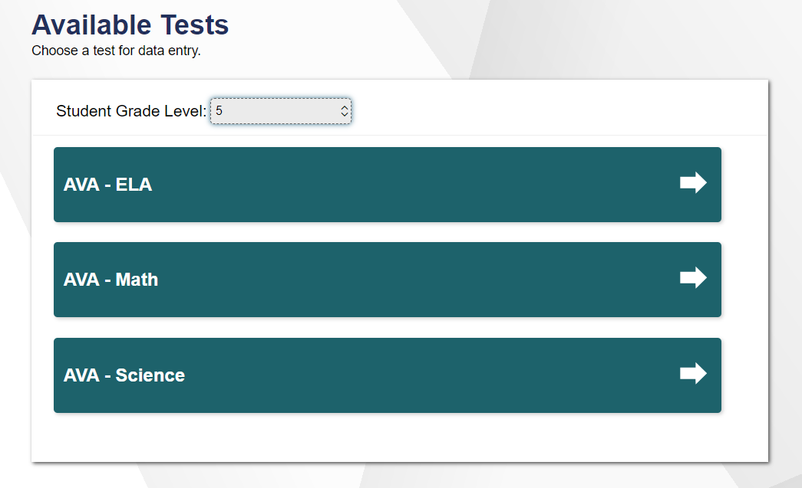
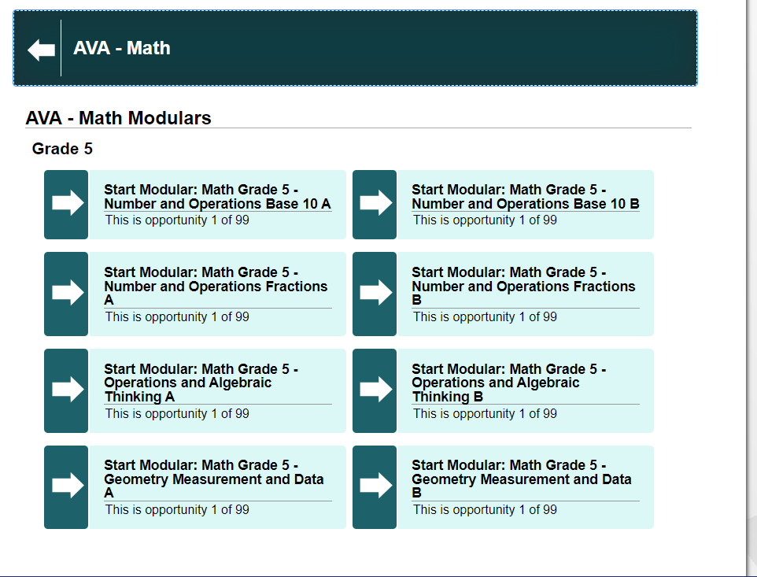
Notes:
Select a grade, then a subject, then a test.
Remember, AVA will only show you fixed-form tests, so you cannot view the Comprehensive Interims for ELA and Math using this platform, as those are adaptive tests.
Once you select a test, you can move through it just like students do, with access to the same tools for zoom, masking, highlighting, and mark for review.
As I mentioned earlier, we have brand-new modular assessments this year, so those of you who have administered modulars in the past will want to take a moment to look at these to see which new assessment suits your needs.

Slide 30
Ways to Use AVA
Preview tests to determine which one is appropriate for your class
Present a “problem of the day”
Review items from previously taken tests
Demonstrate the tools available on the test
Remember – treat items securely!
Notes:
The primary function of AVA is to allow teachers to preview Modular assessments to determine which ones are appropriate for their use case. But there are other ways you can use it!
Some teachers pull up an item in AVA to present a “problem of the day”, which students work on independently or collectively.
If you’ve already given one of the modulars, and you found that a significant number of students in your class got the same item wrong, you can pull it up in AVA and walk through it as a class – addressing common errors they may have made, or asking them what they found difficult about the item.
You can also use AVA as an opportunity to show students, other educators, or even parents what the items look like and how to navigate through the test.
A reminder that these are secure items, so you should not take any screenshots. And of course, never share your username/password with anyone!

Slide 31
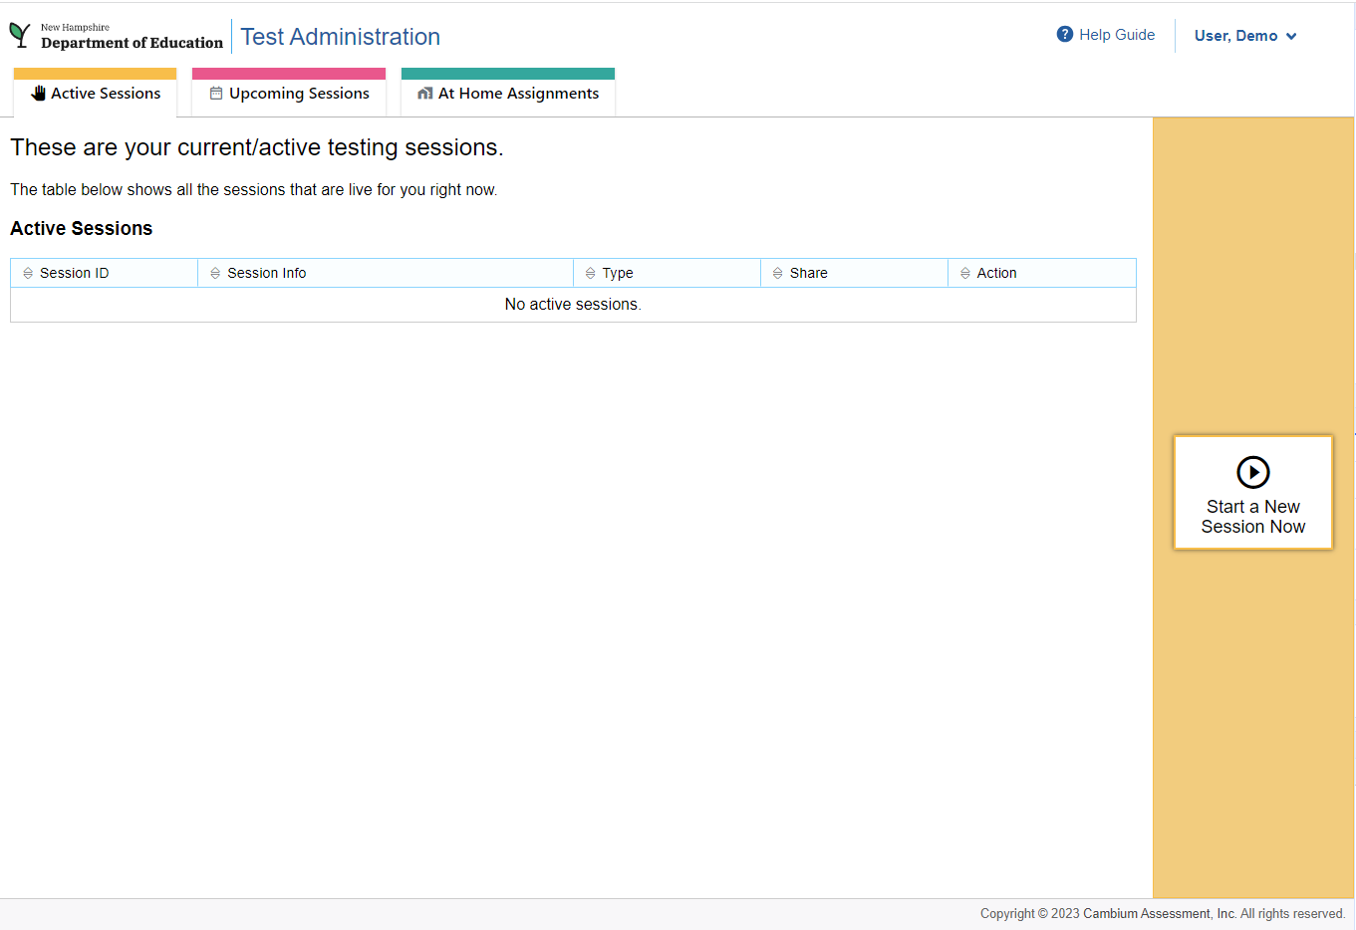
Notes:
Log into the TA Interface using the same username/password you use for all CAI systems, and you’ll see this screen.
To start a session immediately, click “Start a new Session Now”

Slide 32
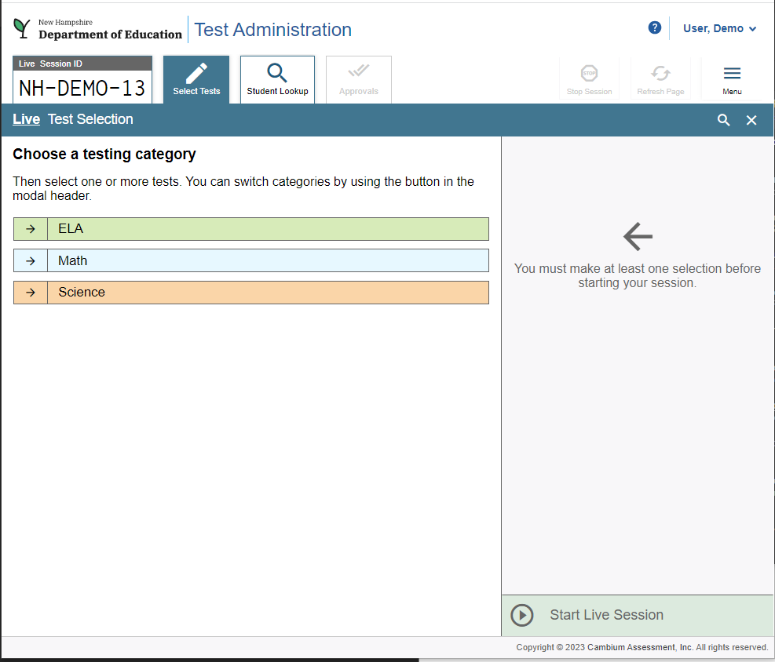
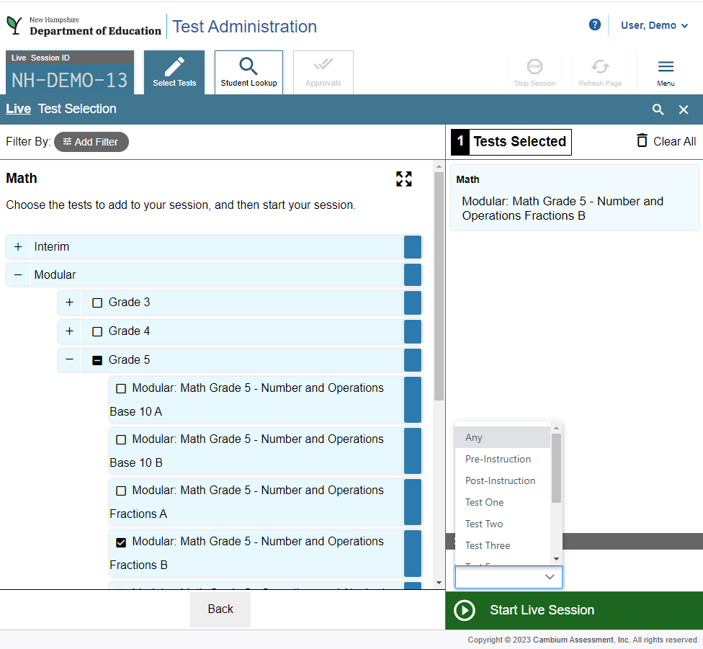
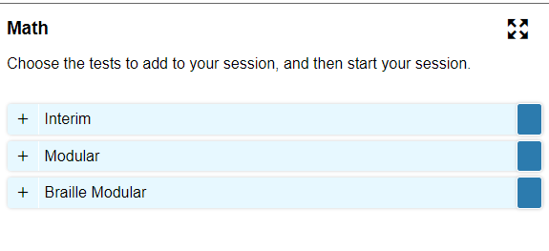
Select Tests
Notes:
You’ll first select a subject, then a category (Interim or Modular), and then the test you want to administer. One thing that is a little different here is that you’ll be asked to select a test reason. This is helpful when you’re looking at your reports later, because you can see if a test was a pre-test or a post-test, for example.
Once you’ve set up your session, hit “Start Live Session” and share your Session ID with students. In this case, the Session ID is “NH-Demo-13”.
Students will need this session ID in addition to their SSID and their first name as it appears in TIDE.
Approve students into the test, monitor testing, and when you’re finished, end the session. Just like the Summatives!

Slide 33
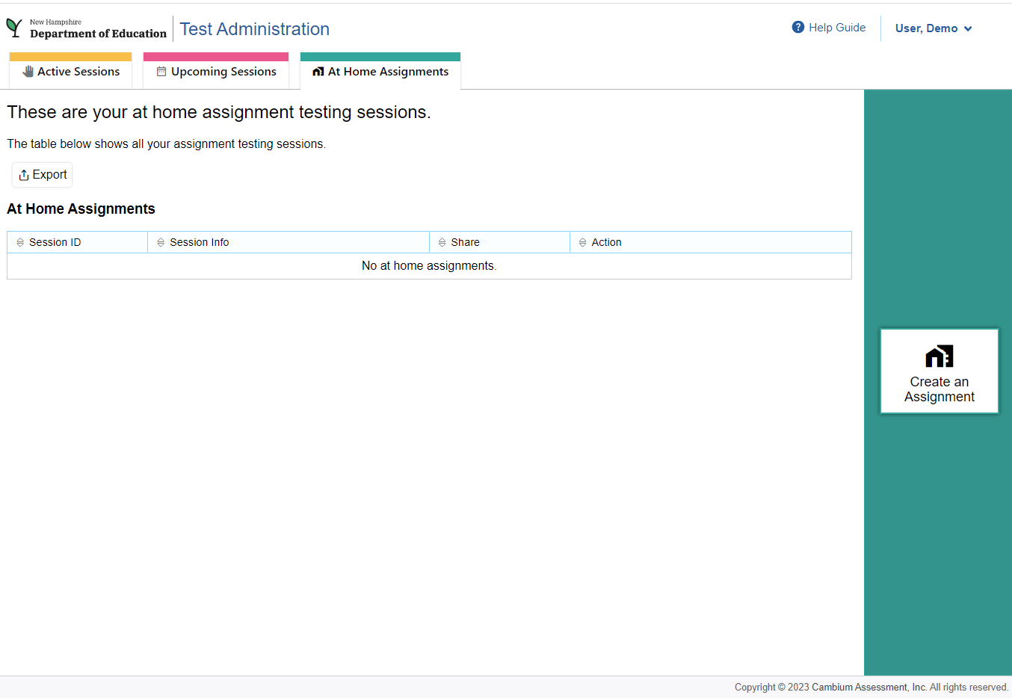
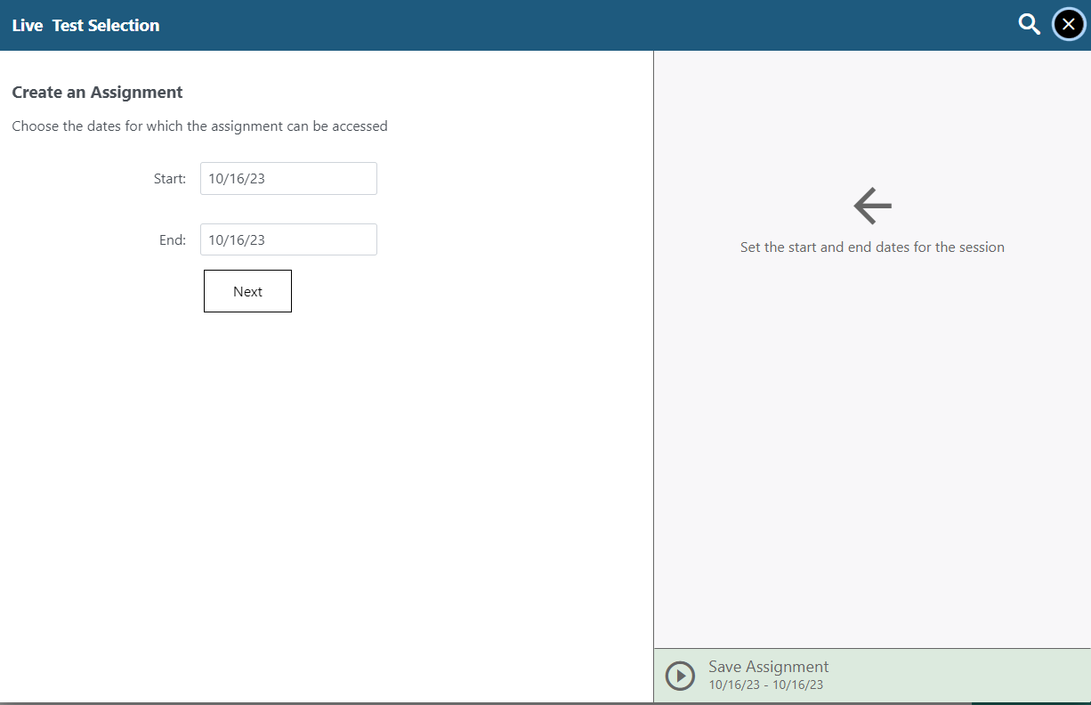
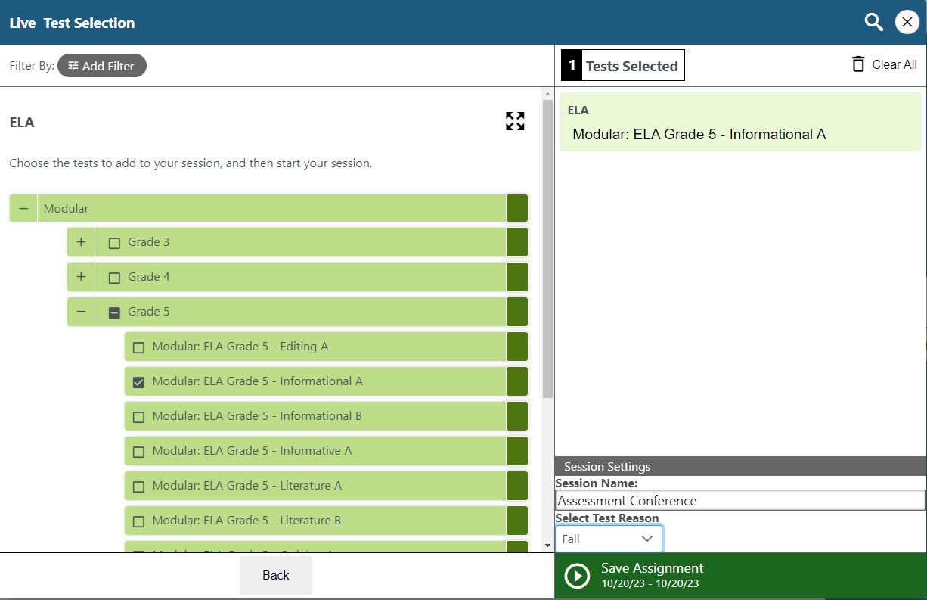
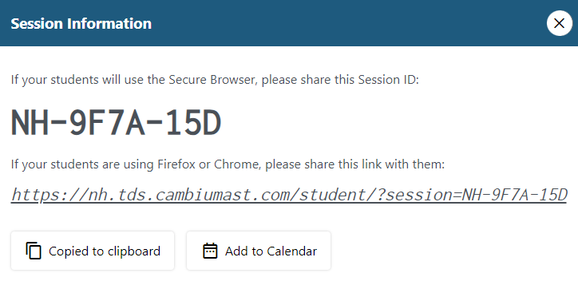
Creating At-Home Assignments
Notes:
One option that exists for the Modulars that doesn’t exist for the Interims or the Sumamtives is the “At-Home Assignments” tool. This allows you to set up test sessions so that students can take the tests at home, as homework. They can use the Secure Browser or a standard browser like Chrome, Firefox, or Safari. If students will be using one of those browsers, you can copy the link and share it with them using your classroom communication tools.

Slide 34
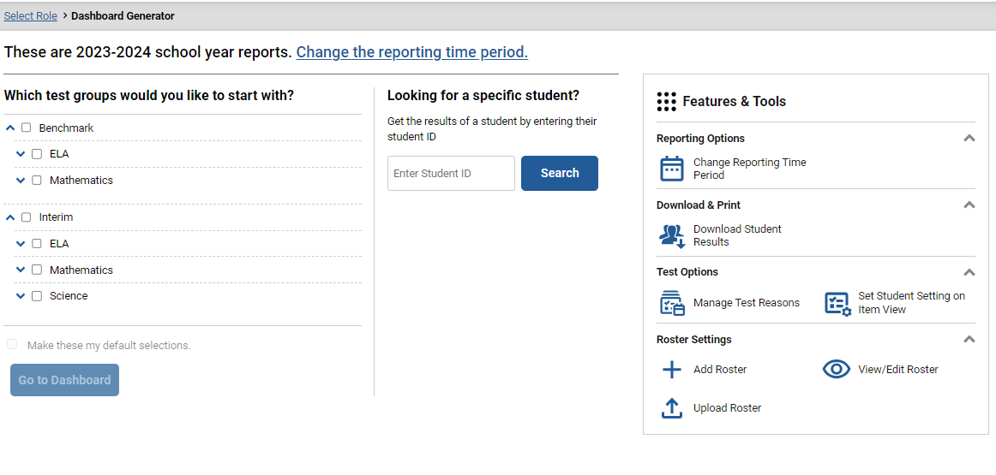
Accessing Score Reports - Setting Up your Dashboard
Notes:
Now we’ll talk about how to access the score reports for the Modulars and Interims.
If you’ve viewed your students’ scores for the Summatives, you’ll be familiar with this process. Navigate to the portal, select the appropriate user card, and then click “Reporting”
Once you log in to the Reporting System, you’ll see this screen. This is for the 2023-2024 school year, so only interims and benchmark modulars are available. From this page you can also search for a specific student to access their scores for all tests, change the reporting time period, or edit rosters.

Slide 35
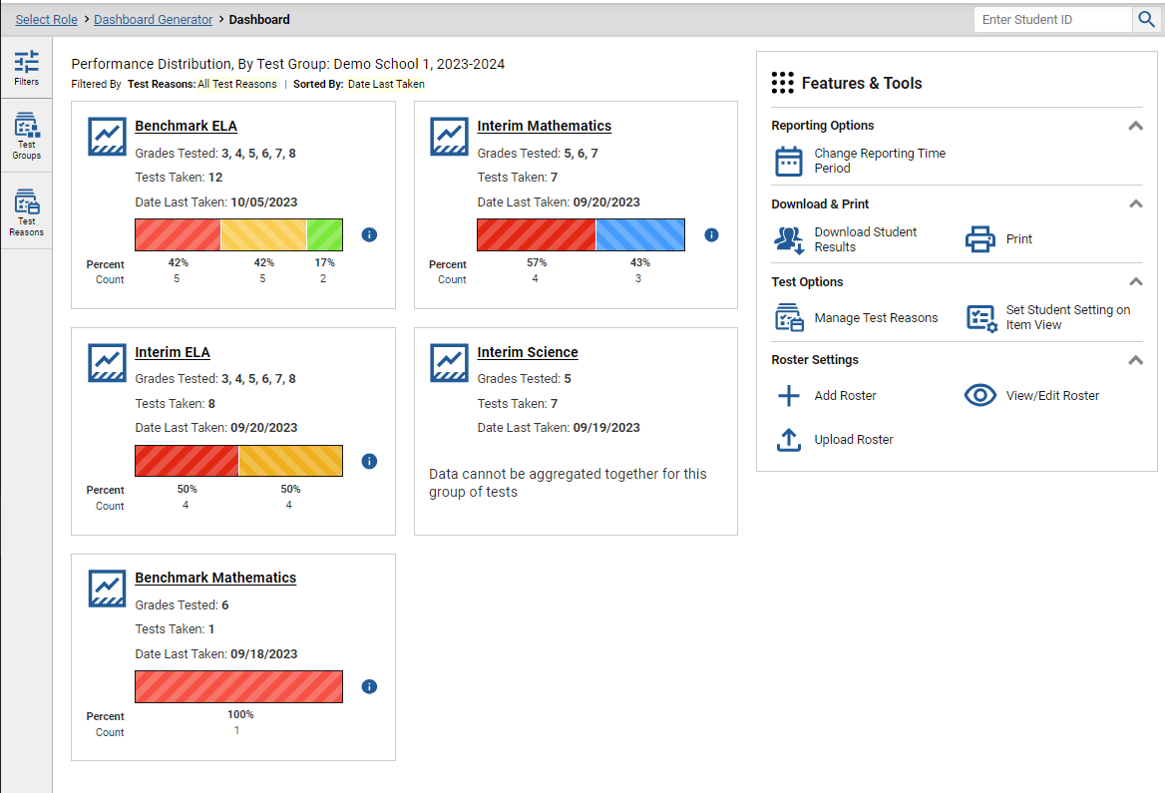
Notes:
Here’s an example of what a dashboard looks like. On this page, I have selected all the possible tests.

Slide 36
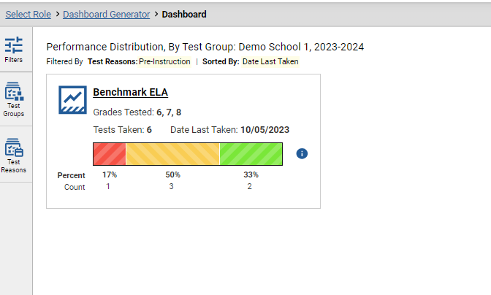
Notes:
If I click on the “Filters” menu, I can filter what I see. The available filters will change based on what you’re looking at, but here on this screen we can see the “test reasons” option. Using this, we can see the tests that were taken using a given test reason. You can see that when I selected “pre-instruction”, the number of tests on my dashboard went down.

Slide 37
Notes:
If I select an assessment family, I then will see the tests in that family. Here I have selected “Interim ELA” and I will see all the Interim ELA tests my students have taken. These are demo students so there’s not the same Normal Distribution you would expect to see with actual students.

Slide 38
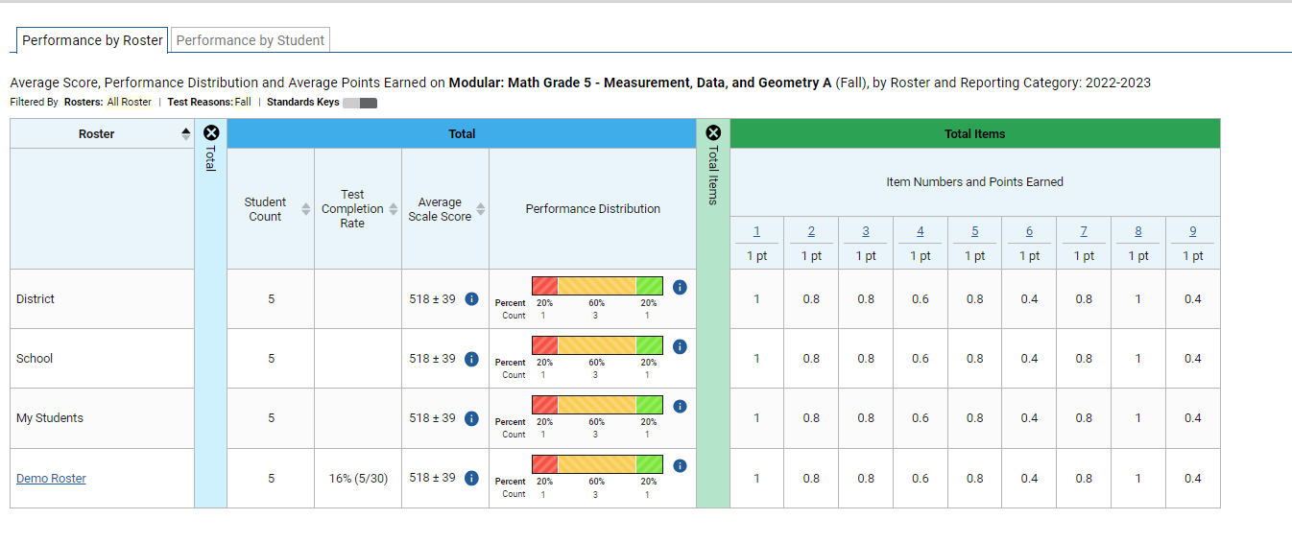
Notes:
Once I select a test, I can see performance on that test. Here I have expanded the results for this modular to show performance by item.

Slide 39
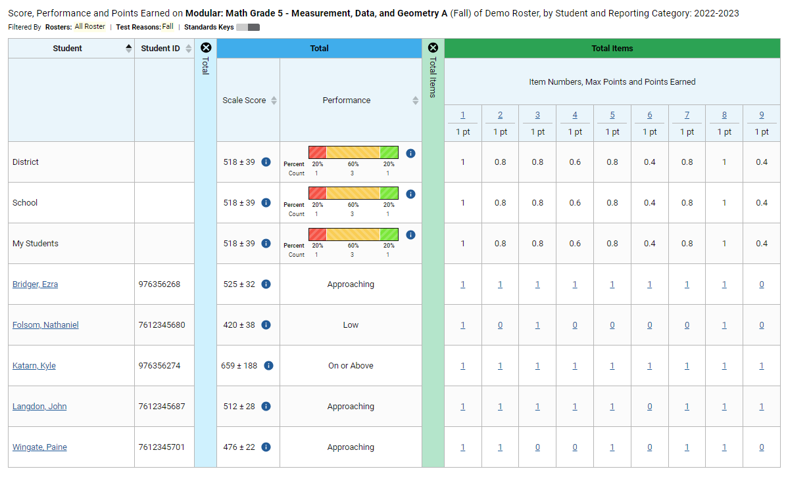
Notes:
If I click on the roster, I can see it broken out by student, and I can see which students got which items correct. Since this is a modular assessment, it’s a fixed-form test and all students saw the same items in the same order. This display isn’t available for interims, because those tests are adaptive. But we can see individual students’ item-level performance. So in this example, we can see that on question number 9, over half the class got 0 points on that item. So this might be an item that is a little more difficult for my students, and this is where we might pull up that item in AVA to work on it as a class and talk about approaches to solving the problem.

Slide 40
Viewing Individual Items
Notes:
This is an example of a math item. I’ve redacted the correct answer for test security reasons, but you can see that this student did not get the answer correct. I’ve also toggled the “student settings” option ON, and you can see that this student has the aqua colored background setting. This feature lets you see the item the way it looks with the student’s embedded settings turned on.

Slide 41
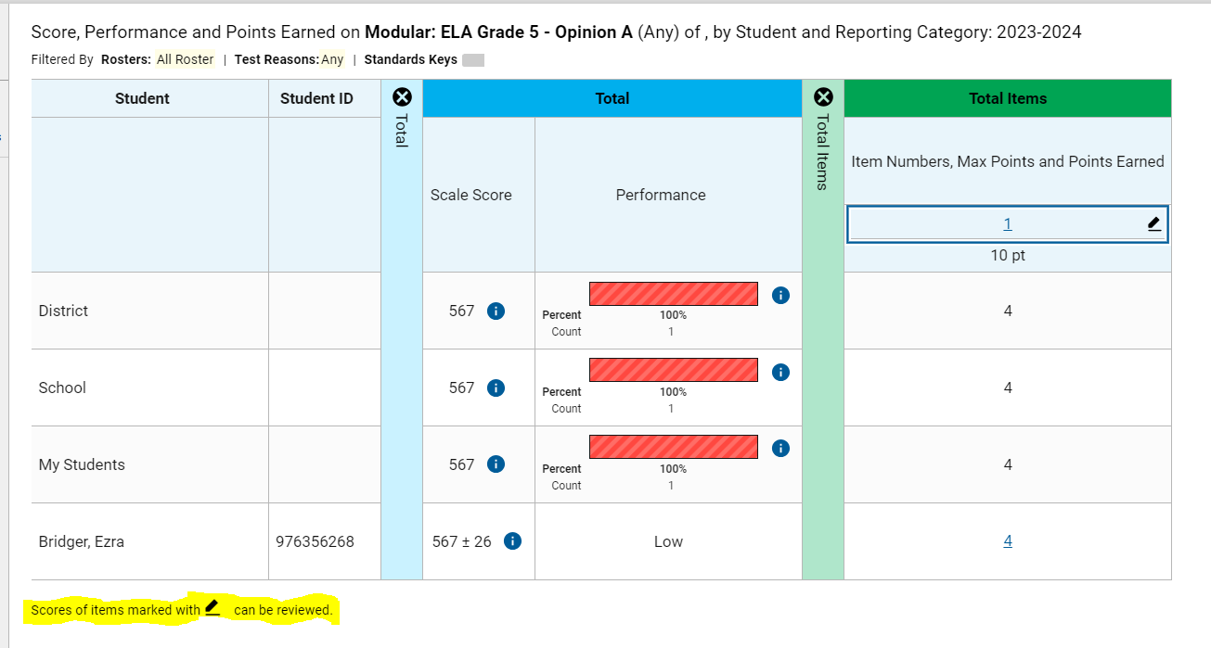
Notes:
One thing to note as you look at the item-level scores for interims and modulars, items that are marked with the pen icon can be rescored. This is one of the things that differentiates these tests from the Summatives – all the items are machine scored but in some cases, a teacher can override that machine score. You might occasionally see an item that is flagged for you as one where the computer thinks you SHOULD review the score.

Slide 42
Changing Item Score
Notes:
In this screenshot, I’m looking at the writing score for my student. At the top I can see the score, and then below you can see what happens if you click that pencil icon – I can change the score and add notes if I want to. If I were to scroll down on this page I would see the prompt that the student saw and also their essay.

Slide 43
Supporting Teaching and Learning
They allow educators to:
Elicit evidence of student learning to inform teaching and learning.
Engage in professional learning.
Deepen teacher content knowledge.
Evaluate grade level instructional progress and plan adjustments to increase learning for all students; and
Observe student use of the testing platform and accessibility supports with actual test items.
Notes:
As we mentioned earlier, the Interims, also known as Interim Comprehensives, are computer-adaptive tests that are shorter than the Summative assessment but which follow the same test blueprint. They can be administered at any point during the course of the school year to assess a class or individual students. The resulting data can help you understand your students’ strengths and weaknesses as you plan your lessons.
Again, these tests can be given off-grade, so, for example, a 5th-grade teacher might choose to administer the 4th-grade Math test in the fall to assess students’ understanding of foundational concepts that will be built on in 5th grade. Based on the results, you might spend more time reinforcing certain concepts or skills that students need to understand in order to grasp the new material you’re presenting this year.
Because these assessments are delivered on the same platform as the Summative assessments, and aligned to the same blueprint, they are also great practice for students as they prepare to take the Summative assessment. If students have practice taking the Interims, then the Summatives will be familiar with them, and we don’t have to worry that students don’t understand how to interact with items, because they’ve been using the same tools all year. This also is a great way to practice using any accessibility technology or other accommodations to ensure that both students and test administrators are familiar with how they work. Again, we never want a student’s first experience with their accommodations to be on the day of the Summative test!

Slide 44
Uses of Modular Assessments
Whole class at beginning, middle and end of unit
Small class groups for progress monitoring
Homework assignments
Individual student assessment of skills
Not used by State for Accountability
Notes:
These are some examples of ways that you can use the Modulars in your instruction.
You can administer them to the whole class as a pre-test or post-test to assess their knowledge both before and after a unit.
You can administer them to small groups of students as a tool to monitor progress.
These assessments can also be given as homework assignments, so that you have the advantage of the assessment data without needing to use instructional time.
As a reminder, these tests are not used by the State for accountability purposes – they are for New Hampshire educators to use to support teaching and learning in their classrooms.

Slide 45
Online Resources
TA Training Course – required for all Proctors administering ANY online SAS test.
TA Training Site – allows educators to practice administering assessments – works with student practice test
User Guides and more – on the Resources section of the NH SAS portal (https://nh.portal.cambiumast.com/)
Embedded into systems
Demonstrated Success – Offers webinars on diving into the data to better understand strengths/weaknesses
Notes:
These are some examples of ways that you can use the Modulars in your instruction.
You can administer them to the whole class as a pre-test or post-test to assess their knowledge both before and after a unit.
You can administer them to small groups of students as a tool to monitor progress.
These assessments can also be given as homework assignments, so that you have the advantage of the assessment data without needing to use instructional time.
As a reminder, these tests are not used by the State for accountability purposes – they are for New Hampshire educators to use to support teaching and learning in their classrooms.

Slide 46
Questions?
Notes:
What questions do you have?

Slide 47
Rosters
Student Reporting Lists to be used
with TIDE and CRS
Evelyn Chester, Cambium Assessment, Inc.

Slide 48
Uses for Rosters
Associating students with teachers
Allows teachers to view results in Reporting
Creating sub-groups of students for testing or reporting purposes
Rosters can be based on any trait, e.g. accommodations, class period, reading group, etc.
Students can be in multiple rosters
CAI does not receive demographic information from i4see
Notes:
What are the functions of rosters in the NH SAS?
The primary function of a roster is to associate students with their teachers. This association allows teachers to view their students results in the Reporting system. Teachers may ONLY view the results of students with whom they are associated via a roster.
Typically, a roster represents an entire classroom or a class period, but you can also use rosters to create sub-groups of students for reporting purposes or for certain tasks prior to testing.
Rosters can be based on any trait – for example, you can make a rosters of all the students who receive a certain accommodation, you can have a different roster for every class period. If you have reading groups, you can roster your students according to that, or maybe you have your classroom broken into houses or teams, you can use those as the basis for a roster.
Students can be in multiple rosters – both multiple rosters for a single teacher, and rosters for multiple teachers. So maybe for example you have a student who is in the same classroom most of the day but who gets pulled out for certain services or instruction, and you want that teacher to see their results, that student can be assigned to a roster for that teacher. Or if you’re doing any kind of team teaching. And of course if students have different teachers for math, English, and Science, they can be assigned to a roster for each of those teachers.
One thing to note is that CAI does not receive any demographic information from i4see about students in New Hampshire. So if you want to be able to compare subgroups based on gender, ethnicity, etc, you’ll need to manually create those rosters.

Slide 49
Roster Guidelines
25-30 students per roster
Max 500
Use consistent naming conventions
Notes:
These are some guidelines for best practices regarding rosters.
As we mentioned, typically a roster includes a single class period or a classroom. While a roster can have up to 500 students, we recommend that you keep it to about 25-30 students.
We also recommend using consistent naming conventions in your roster creation – e.g. Teacher Name-subject-class period. This makes it easier to identify the roster you are looking for when you have mulitples

Slide 50
When to Create Rosters
All rosters must be manually created
Rosters can be created at any point during the school year.
Teachers cannot view their students’ results until those students are associated with them via a Roster
Rosters can be created in TIDE or the Reporting system
Notes:
All rosters must be created manually – we don’t receive any information that can create automated rosters.
You can create a roster at any point during the school year, but teachers cannot view their students’ test results until those students are associated with them via a Roster. So I would definitely encourage you to do it prior to testing.
If you’re having teachers who can’t view their students’ scores, the first thing to ask is “are these students rostered to this teacher?”
Rosters can be created either in TIDE, or in the Reporting system. The process is functionally the same in both systems.

Slide 51
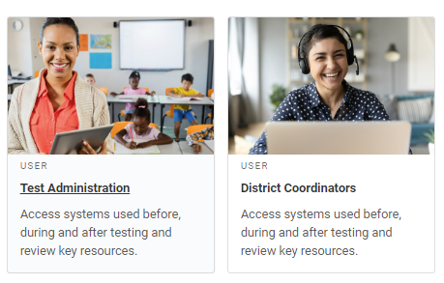
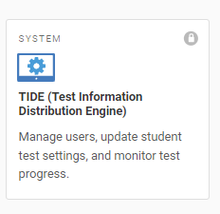
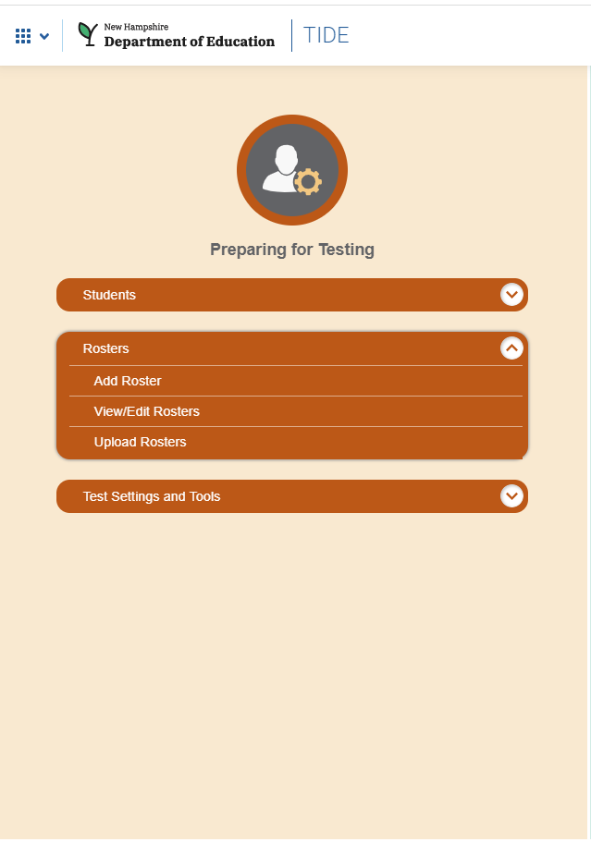
Creating Rosters in TIDE
Log into TIDE using the same username/password you use for all CAI systems
Select “Rosters” in “Preparing for Testing”
Choose which task you’d like to perform – Add, view/edit, or upload
Notes:
To create a roster in TIDE, first log into TIDE using the same username/password that you use for all CAI systems. You can get to TIDE by navigating to the portal, selecting either “test administration” or “District Coordinators” and then clicking on the “TIDE” card.
Once you have logged into TIDE, you’ll see a section on the left labeled “Preparing for testing”. This is where you’ll find the Rosters tool. You can Add a roster, view or edit existing rosters, or upload a roster.

Slide 52
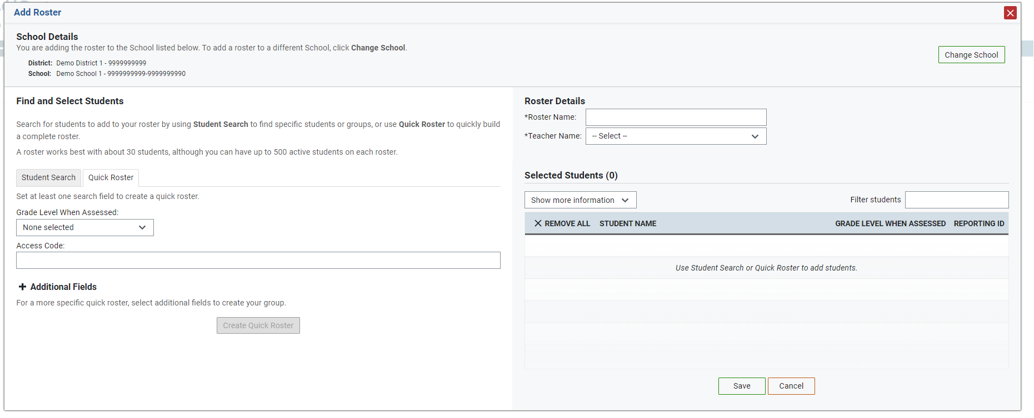
Add Rosters
Notes:
This is a screenshot of the Add Roster interface.
At the top [click], you can see the school details.
On the right [click], you can see the Roster details. This is where you would select the teacher for the roster and also give the roster a name.
Then on the left [click] we see “Find and Select Students”. This is where you search for the students to include in the roster. You can either use the “quick roster” function, which will pull all the students who meet your search criteria, or the “student search” tool, and search for specific students.
Students who are added to the roster will appear [click] on the right, under “selected students”.
We recommend that a roster be about 25-30 students, though you can have up to 500 students in a roster.

Slide 53
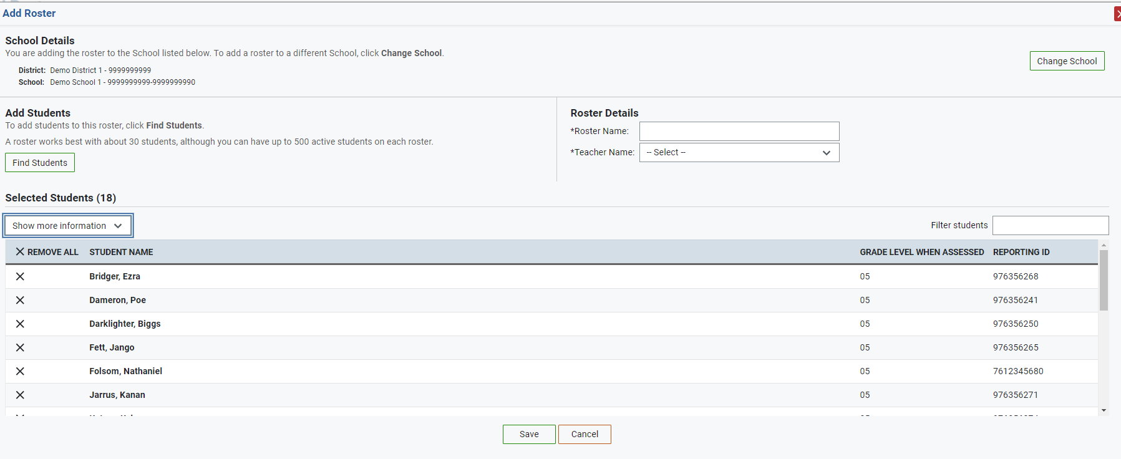
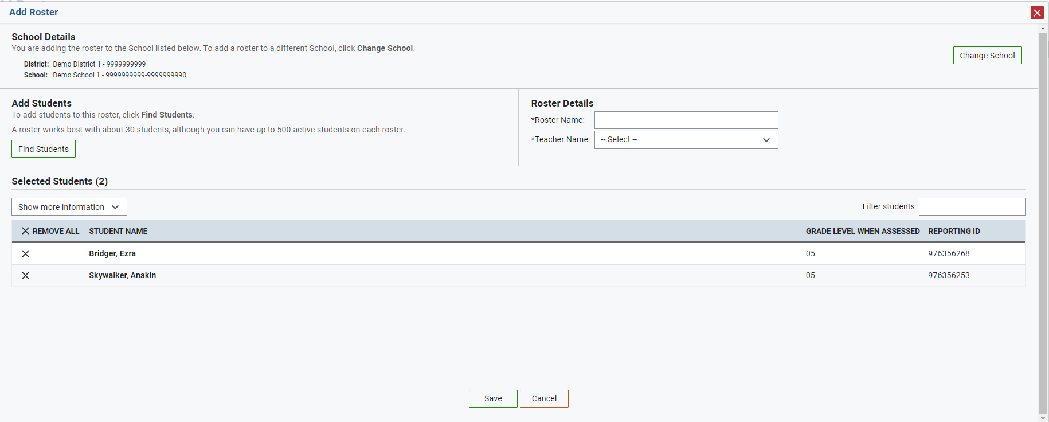
Creating a Quick Roster
“Quick Rosters” are based on search criteria, e.g. grade or test settings
Select your search criteria, then select “Create Quick Roster”
Edit the roster as needed
Notes:
To create a quick roster, select your search criteria, and then select “create quick roster”. In the top example here, I searched for 5th grade students.
If there are students in this roster I don’t want to include, I can remove them by clicking on the “X”.
Remember that CAI does not receive demographic information, so you cannot use this tool to create rosters based on demographic subgroups. But you can search by test settings and accommodations. In the bottom example here, I searched for all 5th graders who use the speech-to-text tool for the ELA test, because I may want to test them in a separate setting so that they don’t disturb other students when they dictate their essays.

Slide 54
Student Search
Notes:
You can also use the “Student Search” tab, which will allow you to search by SSID, name, grade level, or other criteria. Once you do your search, a list of students who meet those criteria will show up [click] on the left hand side. Click the plus to add them to your roster, which appears [click] on the right.

Slide 55
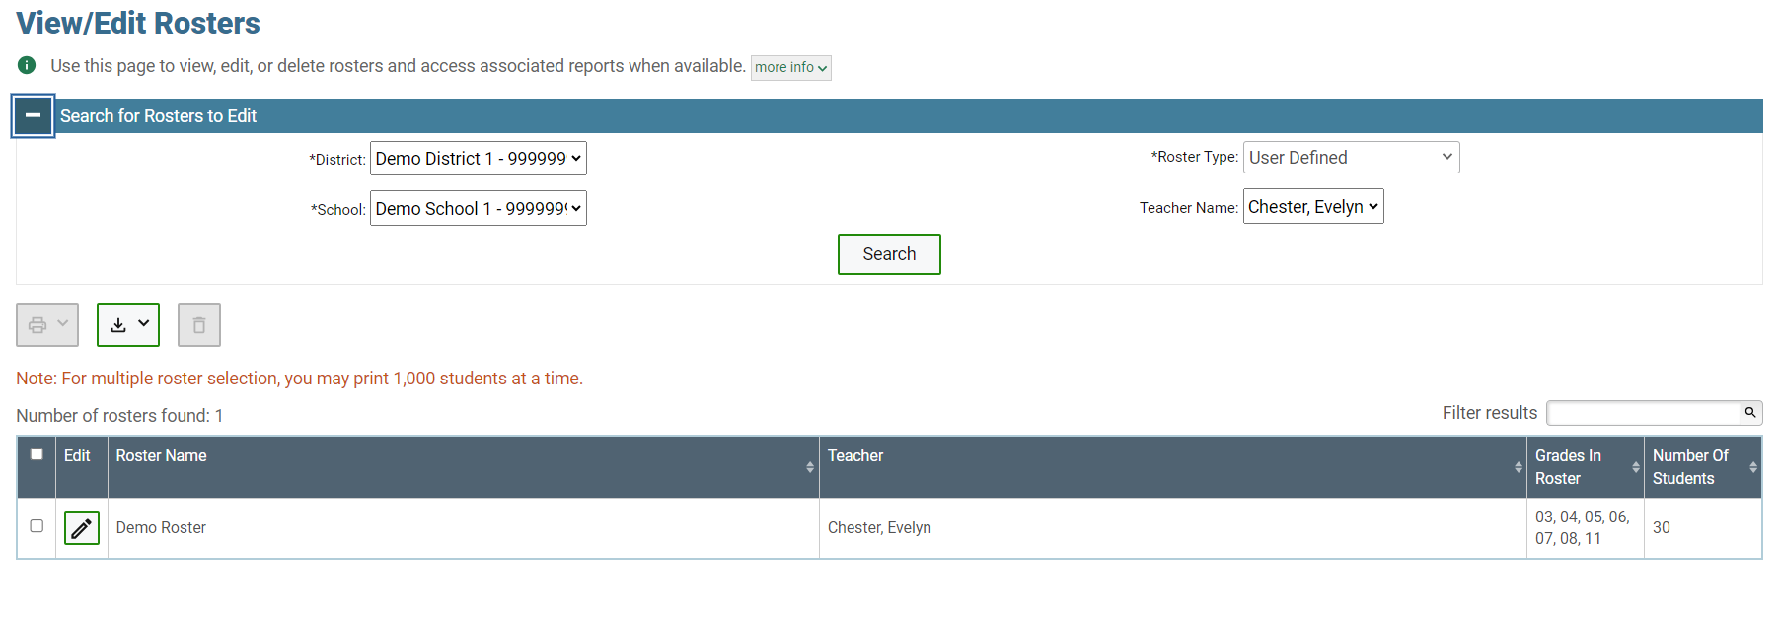
View/Edit Rosters
Notes:
To view or edit existing rosters, click on “view/edit rosters”. Select the teacher whose rosters you want to view, then click search. All the rosters that meet your criteria will show up in the search results pane. In this example, I have one roster.
From here, click the pencil icon next to the roster you want to look at more closely.

Slide 56
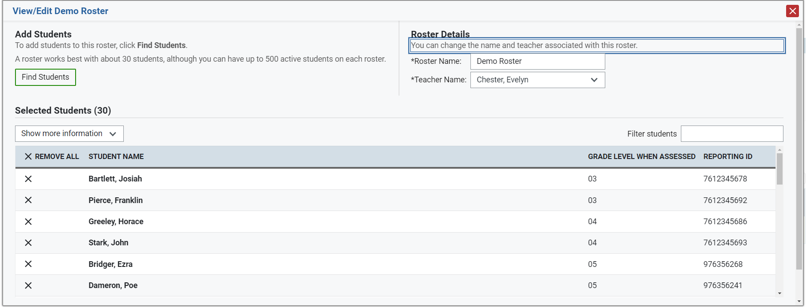
Notes:
Clicking on the pencil icon takes you to the view/edit page. From here I can use the “find students” tool [click] to add more students to this roster, I can click the “x” next to a student’s name [click] to remove them from a roster, or I can change the name of the roster [click].

Slide 57
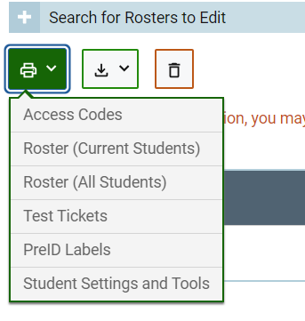
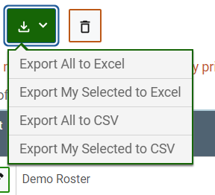
Other Functions
Notes:
From the view/edit rosters page, you can also print Access Codes, Test Tickets, or a list of the test settings and tools for the students in that roster. Or just the roster.
You can also export the roster to Excel or to a CSV file. Make sure the checkbox next to the roster you want to print or download is selected.

Slide 58
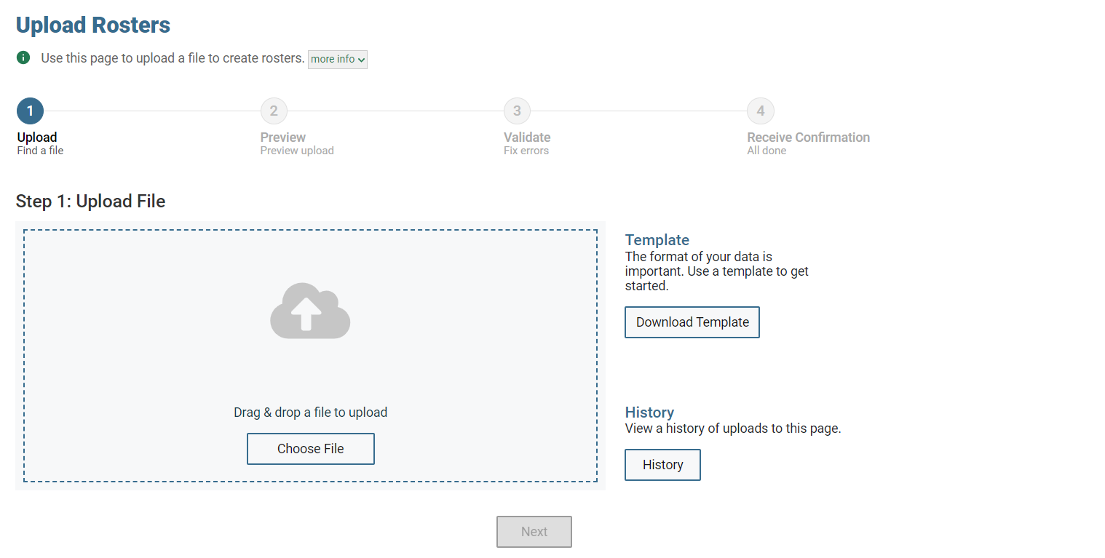
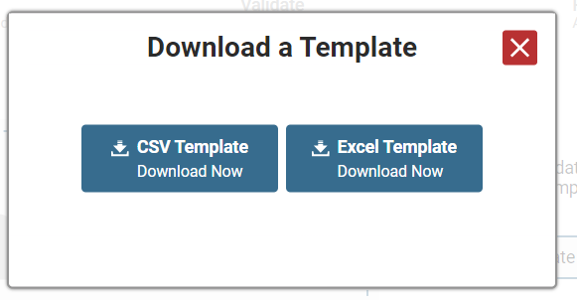
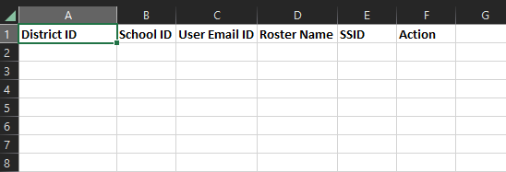
Upload Rosters
Notes:
You can also upload rosters.
To make sure your roster is properly formatted, start by downloading the roster template. Then edit the file, save it, and upload it to TIDE.
In the “Action” field, you can either ADD a student to a roster, or DELETE them from it.

Slide 59
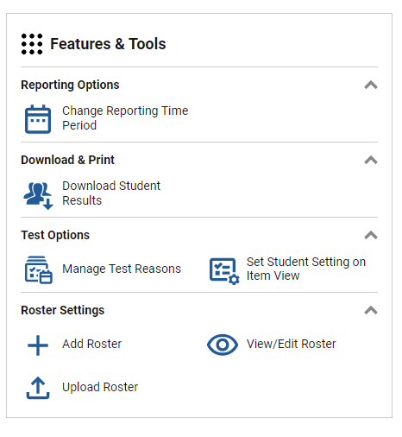
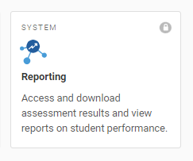
Creating Rosters in Reporting
Notes:
To create a roster in the Reporting System, log into the system using the same username and password you use for all CAI systems. Once you do, on the right side of the screen, under “features and tools”, you’ll see “roster settings”. Select Add, Upload, or View/Edit. The process is exactly the same as it is in TIDE.

Slide 60
Using Rosters Before Testing
Assign students to teachers
Print test tickets
Print lists of students
Print lists of student test settings
Notes:
Here are some ways that Rosters can be valuable prior to test administration –
You can assign students to teachers so that teachers can view their results.
You can print test tickets by roster. Test tickets are documents that provide students with the information they need to log in (name, SSID).
You can print lists of students.
You can print a list of student test settings – this can be useful to verify that students’ settings are correct, or to identify students who may need to test in a separate setting or who may need unique equipment.

Slide 61
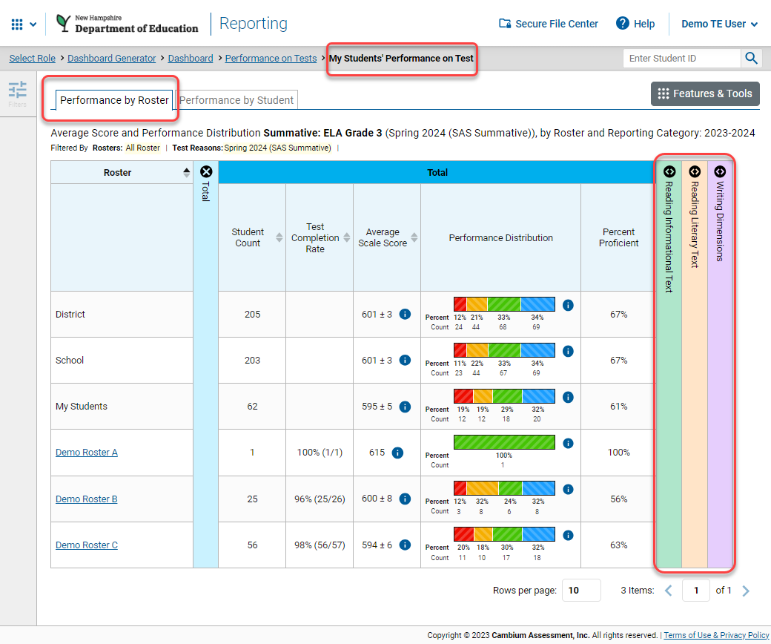
Using Rosters After Testing
View student test results
Compare groups of students
See performance at the group level
Notes:
After testing, rosters are useful in the Reporting system. Teachers can see test results for students who are rostered to them.
Depending on the rosters that you’ve created, this can help you see the performance of different groups of students as compared to each other. You’ll recall we mentioned reading groups in the beginning as a possible example of a roster category. If you’ve created rosters for each reading group, you can compare their performance at the roster level against each other. In this screenshot, you can see that we are looking at the “performance by roster” page, and there are multiple rosters that have different performance breakdowns.

Slide 62
Questions?
Notes:
What questions do you have?

Slide 63
Changes to the Writing Assessment
Julie Benson, Cambium Assessment, Inc.

Slide 64
Overview
Test development background information
Information about writing

Slide 65
New Item/Writing Prompt Overview
Developed new writing prompts for grades 3-8
Opinion/Argument
Informative
Narrative
Replace the summative writing prompts with the new prompts for the SP24 administration
Replenished the interim and modular writing prompts with previously used summative opinion/argument and informative prompts
Develop enough narrative prompts for summative and interim use

Slide 66
Test Development Sequence for Writing Items
Draft new writing passages and items/prompts
Review and revise
Educator content review (CAC)
Bias/Fairness review (FAC)
Final revisions and review
Pilot new writing items
Rangefinding
Develop handscoring materials
Operational Window March 4-15, 2024 (Early writing window necessary for year one only)
Handscore all student responses
Use handscored responses to build scoring models so new prompts will be machine-scored starting SY 24-25

Slide 67
Writing Development Plan
Task | Proposed Dates
Develop Prompts | Winter 2022 - Spring 2023
Cross State CAC and FAC | August 10-11, 2023
Pilot | October 2-13, 2023
Rangefinding | January 2024
Operational Writing Window (SP24 Only) | March 4–15, 2024
Finalize Rangefinding and Training | March 18 - 22, 2024
Handscoring | Start March 25
Calibrations (psychometric work) | Following the close of the testing windows
Final Scores | CAI will work with states to identify specific date for final data file delivery

Slide 68
Writing Items/Prompts and Rubrics
Writing Prompts
Informative and Opinion/Argumentative were developed following the current specifications
Narrative were developed to new specifications
Rubrics
Opinion/Argument and Informative – same 10 point rubric as currently being used in the summative assessment
Narrative – new 10 point rubric aligned to narrative standards

Slide 69
Narrative Writing Prompts
Prompts and rubrics aligned to narrative writing standards
State department folks and educators helped to shape the vision for the narrative writing prompts. There are two types:
Picture and text based
Personal narrative
Educator content advisory committees and bias/fairness advisory committees reviewed all newly developed writing prompts

Slide 70
Educator CAC and FAC Reviews
Review and evaluate new writing items/prompts and passages to ensure each item is an appropriate measure of the content standards and fair to all students.
Alignment
Grade appropriateness
Language and wording
Bias/Fairness

Slide 71
Purpose of Writing Pilot
Purpose of the Writing Pilot:
To administer the new informative, opinion/argumentative, and narrative prompts to students to ensure the prompts are written in a way to elicit appropriate responses.
To collect student responses to conduct rangefinding prior to the SP24 administration.

Slide 72
Writing Pilot
Pilot Window: October 3-12, 2023
Every participating student randomly received 1 writing prompt, either: Opinion (grades 3-5) Argumentative (grades 6-8), Informative, or Narrative
Since the pilot was administered in the fall and students had not received a full year of instruction, writing prompts were given to the grade below for the pilot (e.g., grade 5 students will receive a grade 4 writing prompt)

Slide 73
Writing Pilot
Pilot Window: October 2-13, 2023
Prompts
Grades 3-6: 23 prompts each grade
Grades 7-8: 22 prompts each grade
500 responses per prompt were received

Slide 74
Rangefinding
Purpose of Rangefinding: Educators review and score student responses to set ranges for each of the rubric score points.
Opinion/Argument and Informative 10-point rubric
Focus, Purpose, and Organization 1-4
Evidence and Elaboration 1-4
Conventions 0-2
Narrative 10-point rubric
Organization 1-4
Development 1-4
Conventions 0-2

Slide 75
Rangefinding
Rangefinding
Grade-specific groups
Educators from each state will participate
January 22-26, 2024

Slide 76
Rangefinding
Educators will receive training on rubrics, prompts, and current spring 2023 anchors to ground them in scoring criteria
Each committee will then review the new prompts and passages to develop anchor sets
The anchor sets will be used as a guide to develop specific practice sets, two qualifying sets, and validity responses for each prompt.

Slide 77
Spring 2024 Writing Window
Early SP24 Writing Window
March 4-15
New prompts will be administered and used operationally
Every student will receive 1 writing item/prompt, randomly assigned
Every student will take the writing prompt during the March 4-15 window
Following the window, all responses will be handscored
Handscoring data will be used to train the engine so machine scoring will be available for the SP25 summative administration
During the regular SP24 testing window (April 1 – June 7) students will not take a writing prompt. They will only take reading, math, and science.
The March 4-15 writing window will be used for operational and scoring purposes

Slide 78
Handscoring
The week following the spring writing window, MI will review responses and include additional student responses to the training materials to fill out the responses specifically for high score points which is anticipated
Responses will be double scored with 100% resolution on non-exact scores
Handscoring data will be used to create scoring models for automated scoring going forward

Slide 79
Questions?
Notes:
What questions do you have?

Slide 80
Family Portal
Tom Glorfield, Cambium Assessment, Inc.

Slide 81
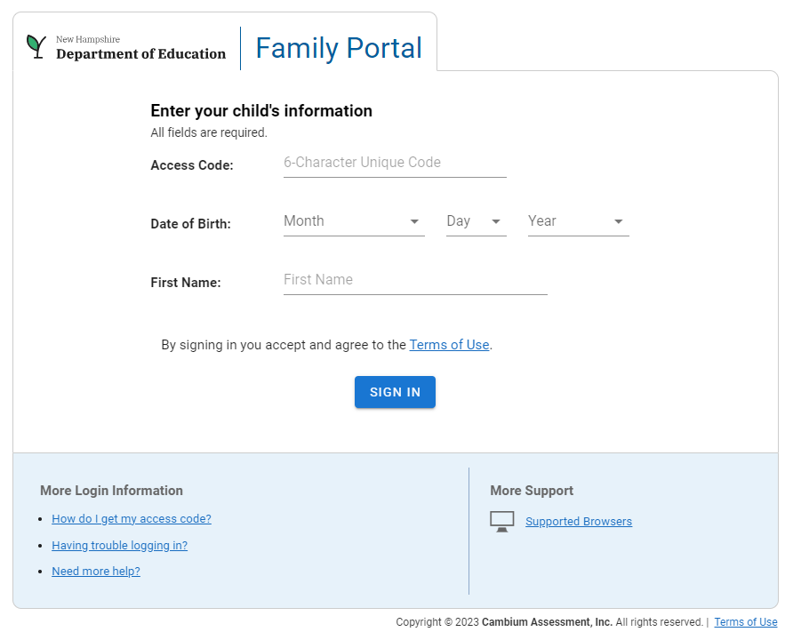
Family Portal Login Page
Notes:
Families in New Hampshire can access their student scores directly from the Family Portal. The family portal is fully integrated with CRS, so scores appear in near real time. This slide shows an image of the login page. Families will need three pieces of information to access their students’ scores:
Access code – this is a six character code that families will get from their school.
DOB
Student’s first name

Slide 82
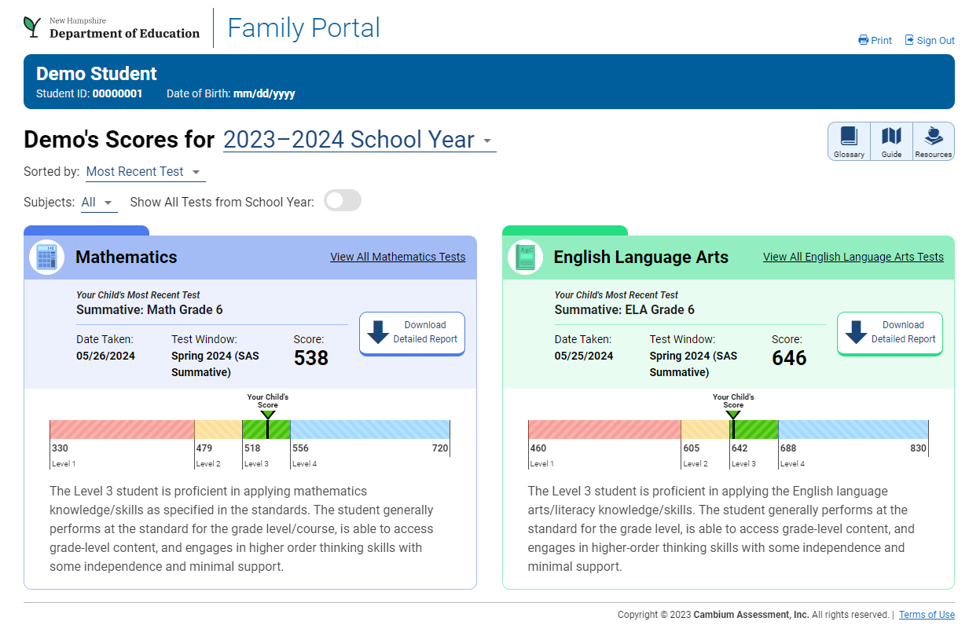
Results Page
Notes:
The first screen that users see after logging in is the landing page. The landing page shows all the student’s most recent SAS tests in order of most date taken. Each test appears in a subject card that displays the student’s overall score, performance level, and text describing the performance level. There is also a Download Detailed Report option in each subject card where the user can download and Individual Student Report, which is the same ISR that is available in CRS.
Users can also view test scores from previous school years using the drop-down at the top of the page.
Finally, there is a glossary, interactive guide, and resources meant to help build families’ assessment literacy.
To advance to the subject page from the landing page, click on the View All link on the top right of any subject card.

Slide 83
Questions?
Notes:
What questions do you have?

Slide 84
NHED Contact Information
Office of Assessment: Assessment@doe.nh.gov
Kristen Crawford, Assessment Administrator
Cell Phone: (603) 931-2084 ̴ Kristen.S.Crawford@doe.nh.gov
Michelle Gauthier, Assessment Specialist
Phone: (603) 271-3582 ~ Michelle.E.Gauthier@doe.nh.gov
Office of Assessment webpage
JoAnn Marchant, Special Education Consultant
Phone: (603) 271-3791 ~ Joann.R.Marchant@doe.nh.gov
Janna Jobel, English Learner and Title III Education Consultant Phone: (603) 568-8813 ~ Janna.M.Jobel@doe.nh.gov

Slide 85
NH SAS Helpdesk
1.844.202.7584
nhhelpdesk@cambiumassessment.com

